Slide 1
Designing your AEMT Course for Success
Richard Belle, BS, NREMT-P

Slide 2
Background
51% initial National Registry pass rate
Much of what is being missed is EMT content and AHA guidelines
AEMT is based on assumption that students are EMTs; not EMT-Bs
Cannot assume either EMT-B or EMT competence
AEMT differs greatly from EMT I-85 and EMT I-99

Slide 3
Background
NEMSES replaced NSC
  Some content changes
    Depth and breadth of A&P
    Pathophysiology of hypoxia and shock
    Additional medical topics
  No DOT objectives
  No detailed content outlines

Slide 4
Bottom Line
AEMT is NOT just EMT-plus-skills
AEMT cannot be retrofitted onto EMT-I structure
Requires planning courses anew

Slide 5
Courses Have Two Goals
Students will learn content
Students will learn how to use content (A Clinical Reasoning Approach)

Slide 6
How ARE the Goals Achieved?
Rethinking course structure and content
Changed teaching/learning philosophy and approach

Slide 7
Overview
Why are we not aligning with what is on the NREMT exam?
What is new with AEMT?
What resources are there to support an AEMT course?
What are effective approaches to AEMT course design and implementation?

Slide 8
NREMT Exams
Additional content, time constraints and current teaching and testing approaches create focus on learning content
NREMT exams do not focus on content, they focus on how to use content

Slide 9
NREMT Exam
The National Registry’s take:
  NR values AEMT
  51% first-time pass rate
  Inadequate focus on Practice Analysis outcomes
  EMT-I/AEMT level has always been problematic
  Significant numbers of questions missed are at EMT-level and on AHA guidelines

Slide 10
NREMT Exam
NEMSES
NR Practice Analysis
Source of curriculum
Top-down
Industry leaders
Evidence-based
Expert writing teams
Source of test items
Bottom-up
Practicing providers
Perception of what is done on the job and the frequency and criticality of each task

Slide 11
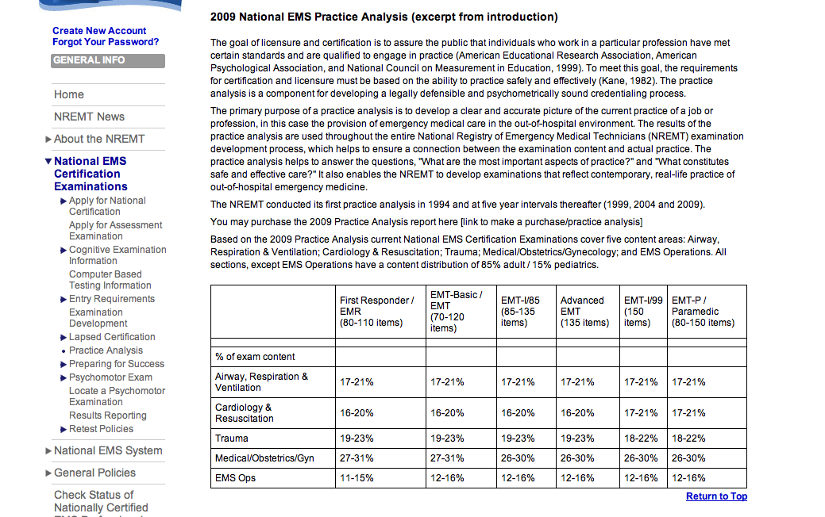
NREMT Exam

Slide 12
What’s New in AEMT
EMT-B: 120 hours
EMT: 150 to 190 hours
AEMT: EMT + 150 to 250 hours

Slide 13
What’s New In AEMT
Content
  Must integrate EMT and AEMT material, not treat AEMT as an “add-on”.
  NASEMSO Gap Analysis
    EMT-B—EMT
    EMT-I 85 and EMT-I 99—AEMT

Slide 14
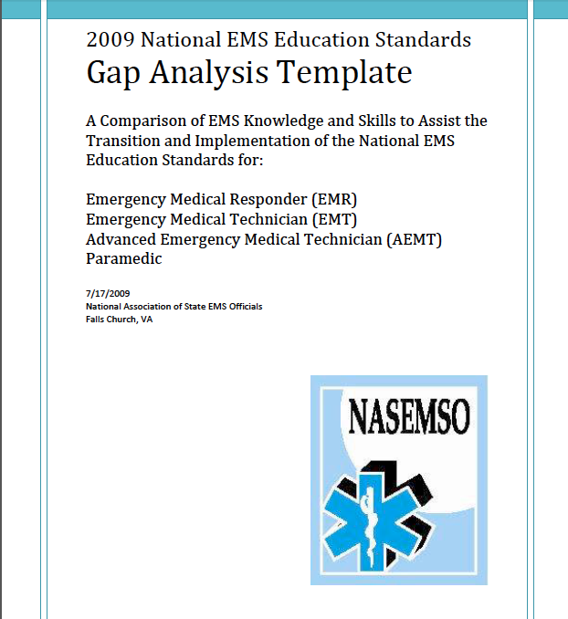

Slide 15
What’s New in AEMT
New material and increased breadth and depth of material:
  All preparatory topics, especially evidence-based decision-making, patient safety and preventing errors
  Public health
  Medical terminology
  Anatomy and physiology, especially ventilation, respiration, and perfusion
  Pathophysiology, especially hypoxia and hypoperfusion
  Pharmacology
  Medical emergencies
  Special patient populations

Slide 16
Resources
NEMSES-based texts:
  Still have objectives
  Have more course support than ever before
    Lesson plans
    Slides
    E-text
    MyBradyLab
    Workbook

Slide 17
Resources
Our situation departs from the typical situation of higher education/health sciences education
Even at the curriculum level, you are not starting from scratch:
  NEMSES
  NEMSES-based textbooks
  NEMSES-based textbook supplements, support, assets

Slide 18
Resources
AEMT text is designed according to effective course structure for a particular course that is similar wherever it is taught
  Content
  Pedagogical structure
  Student support
  Instructor support

Slide 19
Course Planning
Tasks to be completed:
  Develop a course schedule according to your particular situation
  Think less about “covering content” than about total learning time
  Build the course to:
    Encourage active learning
    Be learner-centered
    Promote self-directed learning

Slide 20
(Not So New) Areas of Challenge
Outcomes:
Certification Exam & OTJ Performance
Student Characteristics
Time
Teaching Methods

Slide 21
Challenge Area #1:
Student Characteristics
Ability and knowledge
Academic skills
  Understanding the value of preparing for class
  Reading for meaning
  Taking notes
  Reviewing & integrating information
  Test-taking

Slide 22
Challenge Area #1:
Student Characteristics
We have accepted and adapted to low-expectations for our students.
  “My students can’t read.”
  “My students don’t read.”
  “My students don’t have good study skills.”
Why should they, if there aren’t any consequences?
Reading and reading comprehension are bona fide professional requirements. If students aren’t competent, they aren’t ready for the class.

Slide 23
Challenge Area #2:
Time
Why do we need time?
  Learning is incremental
  Cannot rewire human brain
  Even the best learn only what it takes to answer test questions
  Recognize and solve clinical problems

Slide 24
Challenge Area #2:
Time
Acceptable outcomes require time commitment
Students and instructors
  3:1 study-to-class ratio
  8 hours a day, 5 days a week requires 160 hours in a week engaged in teaching/learning activity

Slide 25
Challenge Area #2:
Time
Instructors:
  Lots of info in little time
  Inadequate prep time
Students:
  Lots of info in little time
  Inadequate learning time between in-class sessions

Slide 26
Challenge Area #2:
Time
Decisions:
  How to distribute learning outcomes throughout the time allotted
  Think of total learning time, as opposed to in-class time

Slide 27
Challenge Area #3:
Effective Teaching Methods
What can we do in the time we’re allotted?
Effective methods for:
    “Delivering” content
    Teaching clinical reasoning and problem-solving
    Enhancing transfer of learning

Slide 28
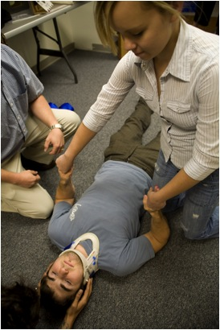
Problem Solving is Cognitive
That’s why we call it critical thinking
Poor providers make cognitive mistakes
Skills are easy

Slide 29
Problem Solving is Cognitive
Why do we focus on psychomotor skills?
  Visibility to instructor vs. inability to “see” complexity of thought behind action
  Easy to correct mistakes

Slide 30
New Paradigm
Stop focusing on “covering material” in class
Stop talking about active learning, student-centered learning, and self-directed learning but doing things the way they’ve always been done in EMS
Create a course that brings about these things
Stop thinking of yourself as a teacher; teaching puts the focus of action on the instructor, not the student
Think of yourself as a designer of learning opportunities
Change the approach to student evaluation

Slide 31
Teaching/Learning Methods
Flipped classroom
MyBradyLab
Team-based learning
Problem-based learning

Slide 32
Course Planning
The flipped classroom places content acquisition outside the classroom and opportunities for application inside the classroom
Lecture is no better for delivering content than reading, watching videos, listening to podcasts
Students should acquire content outside of class and come to class prepared to use the content
This paradigm change is pervasive throughout higher education, including within medical schools. (Same challenges of more information, restricted time, problems in application)

Slide 33
Objectives: From “Know” to “Do”
“Know” objectives
  Define key terms
  Identify anatomy
  List signs and symptoms
“Do” objectives
  Given a scenario, apply understanding of assessment and pathophysiology to identify immediate threats to life
  Given a scenario, develop hypotheses about the patient’s problem
  Evaluate the pros and cons of a proposed treatment plan

Slide 34
Typical Teaching Methods
Instructor courses often tell us the don’ts – what are the dos?
Active learning means cognitive engagement

Slide 35
Orchestrate for Active Learning
Clarity and organization
  Build understanding
  Create a foundation
  Add layers of complexity
Notes:
Team-Based Learning also has exactly these features needed to orchestrate for active learning.

Slide 36
Orchestrate for Active Learning
Provide multiple opportunities to engage with the content through thinking exercises and collaborative conversations

Slide 37
Orchestrate for Active Learning
Opportunities to apply understanding and problem-solving before being tested
  Practice tests
  Low-stakes tests
  Homework
  Feedback

Slide 38
Instructional Methods
Case studies, problem-based learning, discussions, questions, well-organized lectures
Lectures that present information in meaningful ways
  Explaining
  Illustrating
  Comparing and contrasting

Slide 39
Team-Based Learning
Class focus: how to use key concepts
Instructors design & manage educational process
Students are held accountable

Slide 40
Overall Sequence for Each Unit
Initial Exposure Readiness Assessment Practice Applying Concepts Unit Assessment
In Class:
Primarily Group Work
Mini-Lecture based on self assessments.
Group Work on Simple Problems: In-Class Activity
Group Work on Complex Problems
Review
Graded Problem Solving: Exam
Study Basic Concepts: Read Chapters
Readiness Assessment: Individual & Group Quizzes
Work on Simple Problems: Homework
Work on Complex Problems: Homework
Review
Outside Class: Primarily Individual Work

Slide 41
Examples
Basic lesson structure:
  Out of class:
    Student reads AEMT Chapter
    Takes pre-test on MyBradyLab
    Uses remediation assets
    Takes post-test

Slide 42
Examples
Basic lesson structure:
  In-class:
    Mini lecture based on pre-test scores
    Group projects for application
  Out-of-class:
    Homework

Slide 43
Summary
AEMTs are important to the EMS community
Current issue of low NR pass rates
Significant content changes from NSC to NEMSES
Course planning has to consider NEMSES and NR Practice Analysis
Use active learning approaches that teach problem-solving

Slide 44
Questions/Contact Info
Melissa Alexander: melalexander1@gmail.com
Richard Belle: rbelle@acadian.com
Thank you!

