Slide 1
Kentucky Board of Emergency Medical Services
HIV/AIDS Education for EMS Providers
2021
Notes:
Welcome to the Kentucky Board of EMS HIV/AIDS education for EMS providers.

Slide 2
Introduction
KRS 311A.120 Education and Continuing Education - states, as a condition of being issued a certificate or license as an emergency medical technician, advanced emergency medical technician, emergency medical responder, or paramedic, the applicant shall have completed a Kentucky Board of Emergency Medical Services-approved educational course on the transmission, control, treatment, and prevention of the human immunodeficiency virus and acquired immunodeficiency syndrome with an emphasis on appropriate behavior and attitude change.
Notes:
This course meets the education requirement found in KRS 311A.120 Education and Continuing Education – which states, as a condition of being issued a certificate or license as an emergency medical technician, advanced emergency medical technician, emergency medical responder, or paramedic, the applicant shall have completed a Kentucky Board of Emergency Medical Services-approved educational course on the transmission, control, treatment, and prevention of the human immunodeficiency virus and acquired immunodeficiency syndrome with an emphasis on appropriate behavior and attitude change.

Slide 3
Objectives
Upon Completion, The Participant Will Be Able To:
Identify common Bloodborne Pathogens, their harmful effects and methods of transmission.
Describe protection measures for Bloodborne Pathogens.
Describe control and prevention methods of HIV and current recognized methods of medical treatment.
Understand the purpose of an Exposure Control Plan and its components.
Understand the training and recordkeeping requirements for employees.
Understand the importance of staying current on HIV/AIDS issues.
Notes:
Upon Completion, The Participant Will Be Able To:
Identify common Bloodborne Pathogens, their harmful effects and methods of transmission.
Describe protection measures for Bloodborne Pathogens.
Describe control and prevention methods of HIV and current recognized methods of medical treatment.
Understand the purpose of an Exposure Control Plan and its components.
Understand the training and recordkeeping requirements for employees.
Understand the importance of staying current on HIV/AIDS issues.

Slide 4
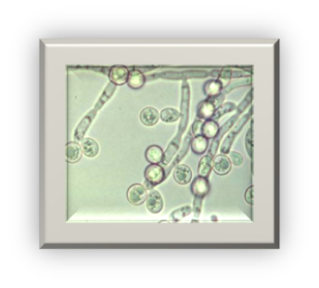
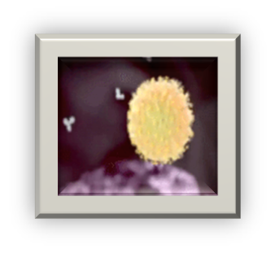
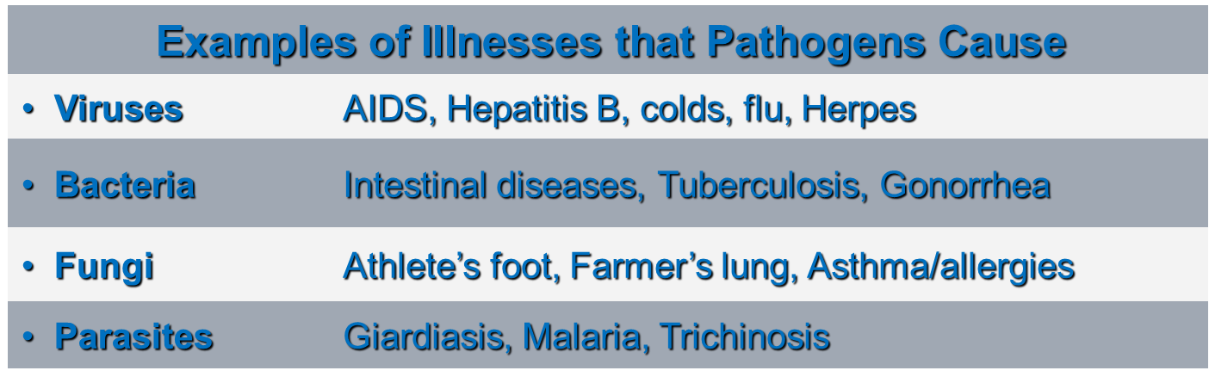


Overview
Pathogen: A Microorganism That Can Cause Disease:
Notes:
Microorganisms that cause diseases are generally referred to as pathogens. They are generally classified into four main groups: 1) Viruses: Are extremely small infectious agents that are basically packages of genetic material. They can reproduce only within cells of living hosts by taking over and forcing the host cells to reproduce the virus. Some examples of illnesses they cause include AIDS (caused by HIV); Hepatitis B; a variety of colds and flus; and Herpes. 2) Bacteria: Are one-celled living organisms that do not require a living host cell to reproduce. E.coli and salmonella are a couple of examples that cause intestinal diseases; tuberculosis and gonorrhea are other examples. 3) Fungi: Fungi include yeasts and molds. They are single or multi-celled plants that live by decomposing and absorbing the organic material in which they grow. They can cause diseases such as Athlete’s Foot, Ring worm, and Farmer’s Lung, and cause asthma and allergies. 4) Parasites: Are single or multi-celled plants or animals that live upon, or within, other living organisms (hosts) from which they obtain some advantage, like nutrients. Some examples include giardia (beaver fever); malaria; and trichinosis. Trichinosis is caused by eating raw or undercooked pork and wild game products infected with the larvae of the Trichinella worm.

Slide 5


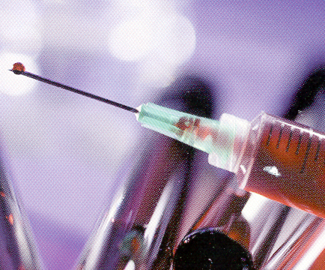
Transmission of Diseases
Routes Of Transmission:
Inhalation
Air
Ingestion
Contaminated food,
water
Contact
Bloodborne
Notes:
Routes of Transmission: The first step in preventing disease is to keep the organism from entering the body. There are three primary routes of entry: 1) Inhalation: A pathogen is usually carried on respiratory droplets in the air and enters the respiratory system; for example, colds, flu, and tuberculosis are transmitted when an infected person coughs or sneezes and spreads the microorganism through the air to others. 2) Ingestion: The pathogen is ingested, usually via contaminated hand or food. For example, in food-borne outbreaks of Hepatitis A, the virus is shed in the feces of an infected restaurant worker who doesn’t wash his/her hands properly after going to the bathroom, and then spreads the virus by handling or preparing uncooked foods or foods after cooking. 3) Bloodborne contact: This is the focus of today’s training. In the following slides, I will explain how Bloodborne diseases are transmitted, which diseases are of primary concern, their incidence and prevalence, and the symptoms of these diseases.”

Slide 6



Bloodborne Pathogens
Bloodborne Pathogens Are Microorganisms:
Present in
Blood
Notes:
Bloodborne Pathogens are microorganisms that are present in blood or other potentially infectious materials (OPIM) and can cause disease. Blood includes Human blood, human blood components, products made from human blood, and medications derived from blood (e.g., immune globulins, albumin, etc.).

Slide 7
Bloodborne Pathogens (Continued)
Other Potentially Infectious Materials (OPIM):
Semen
Vaginal secretions
Saliva (If blood is present)
Breast Milk
Body fluids such as:
  Pleural
  Cerebrospinal
  Pericardial
  Peritoneal
  Synovial
  Amniotic
Any unfixed tissue or organ from a human (living or dead)
HIV or HBV containing cultures, culture medium, or other solutions.
Blood, organs, and tissues from animals infected with HIV, HBV, or other BBPs
Notes:
Other Potentially Infectious Materials (OPIM) include Certain body fluids or tissues that may contain Bloodborne Pathogens, such as: (Run through the list.) Other body fluids and materials, such as saliva, tears, urine, and feces, are not considered OPIM unless they are contaminated with blood or with the OPIM body fluids or tissues listed on this slide.

Slide 8
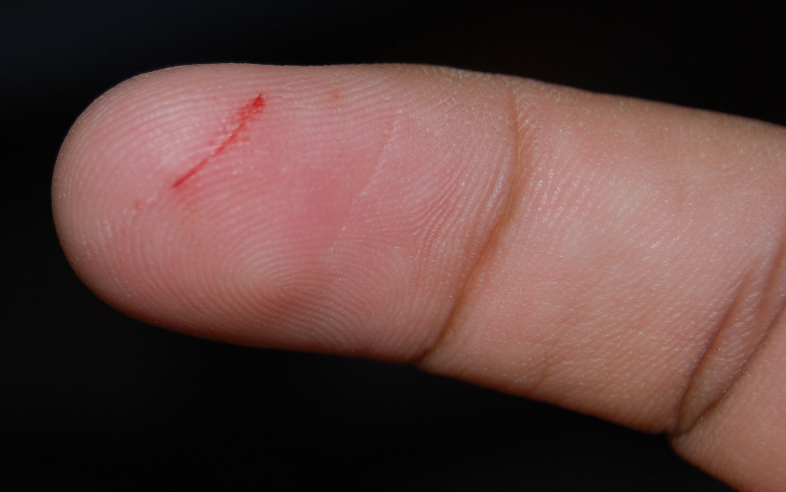
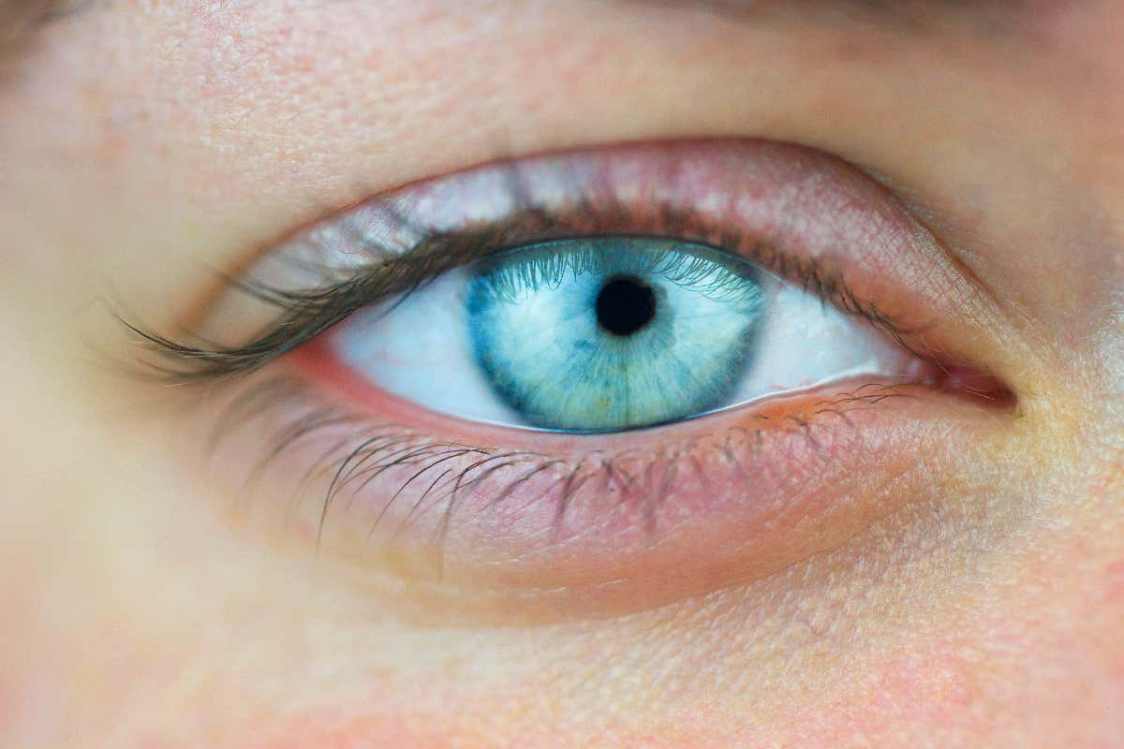
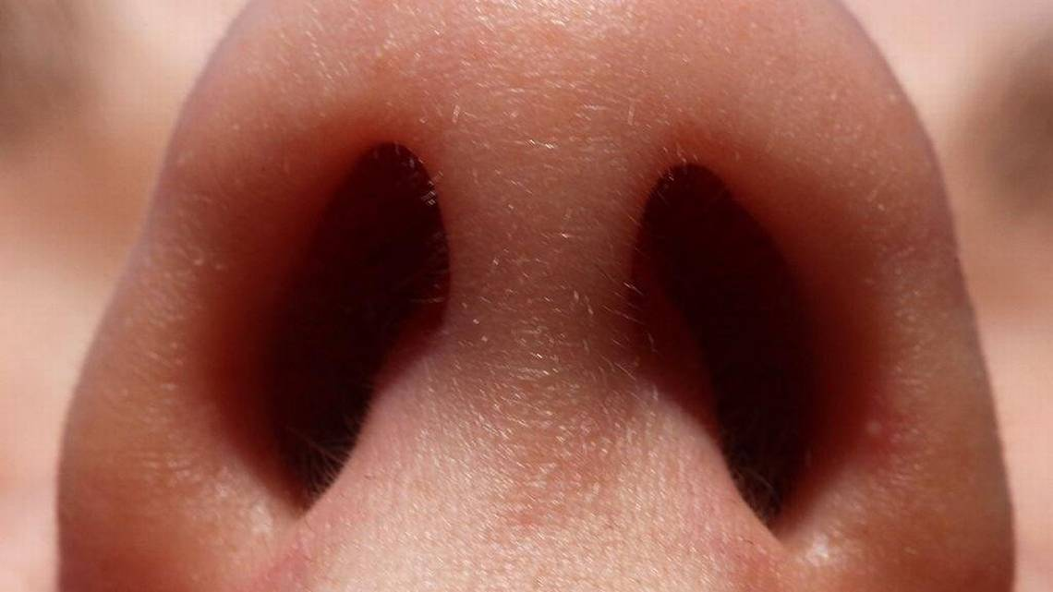
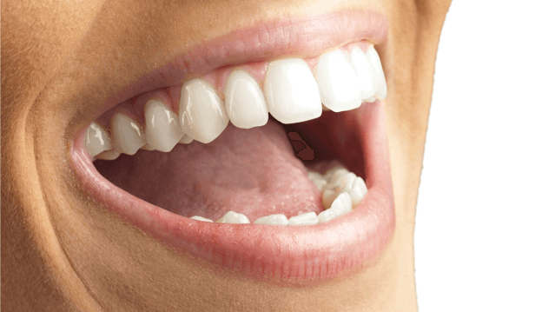
Transmission of Bloodborne Pathogens
Bloodborne Pathogens Can Enter Your Body Through:
A break in the skin (cut, burn, lesion, etc.)
Mucus membranes (eyes, nose, and mouth)
Sexual contact
Other modes
Notes:
In an infected person, Bloodborne Pathogens are transmitted to another person when infected blood or body fluids (OPIM) and can gain entry through another person’s blood, mucus membranes, or by sexual contact. Intact skin will prevent the transmission of Bloodborne Pathogens because BBPs cannot penetrate intact skin. Non-intact skin – skin that is chapped (cracked) or has cuts, abrasions, lesions, acne, or other openings, or is afflicted with dermatitis – will not. You can, however, become potentially infected if you have infected blood or OPIM on intact skin, for example on your hand, and then you rub your eyes, thus allowing a route of entry through the eyes. Other modes of transmission can include perinatal but will be discussed when we go over the individual BBPs of concern.

Slide 9
Transmission of Bloodborne Pathogens (Continued)
Risk Of Infection Depends On Several Factors:
The pathogen involved
The type/route of exposure
The amount of virus in the infected blood at the time of exposure
The amount of infected blood involved in the exposure
Whether post-exposure treatment was taken
Specific immune response of the infected individual
Notes:
Most exposures do not result in infection. Following a specific exposure, the risk of infection may vary with factors such as: 1) The pathogen involved 2) The type or route of exposure 3) The amount of virus in the infected blood at the time of exposure 4) The amount of infected blood involved in the exposure 5) Whether post-exposure treatment was taken 6) The immune status and specific response of the infected individual. (Note: the graphic shows the tip of an injection needle.)

Slide 10
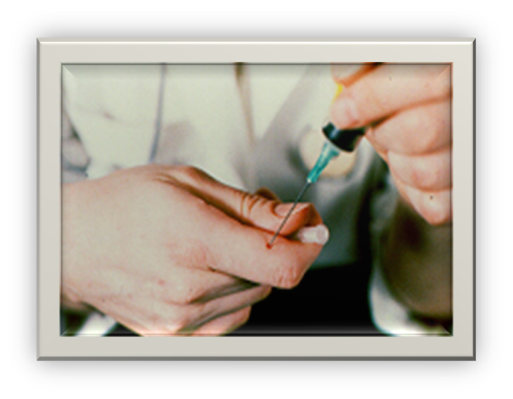
Transmission of Bloodborne Pathogens (Continued)
Occupational Exposure:
Means reasonably anticipated skin, eye, mucous membrane, or parenteral (piercing of the skin) contact with blood or OPIM that may result from the performance of an employee's duties
Exposure Incident:
Is a specific contact with blood or OPIM that can transmit a bloodborne disease
Notes:
At the workplace, Occupational Exposure means reasonably anticipated skin, eye, mucous membrane, or parenteral contact with blood or OPIM that may result while an employee is doing his or her job duties. ‘Reasonably anticipated’ contact means potential contact as well as actual contact with blood or other potentially infectious materials. “An Exposure Incident is a specific contact with blood or OPIM that is capable of transmitting a Bloodborne disease.
(Parenteral or percutaneous contact - contact through a piercing of the skin, such as by needle sticks, cuts, or abrasions). Needle stick injuries are the most common cause of occupational exposure to BBPs. Data from the CDC shows that approximately 38% of percutaneous injuries occur during use and 42% occur after use and before disposal. Most needle stick injuries have been associated with hollow bore needles. Other exposures from contaminated sharps may include scalpels, broken glass, broken capillary tubes, exposed ends of dental wires, and any other contaminated object that can penetrate the skin. Exposure can also occur from contact of the eye, nose, mouth, or non-intact skin with contaminated blood.

Slide 11
Bloodborne Pathogen Diseases
Some Examples Of Bloodborne Pathogens:
Hepatitis B Virus (HBV)
Hepatitis C Virus (HCV)
Human Immunodeficiency Virus (HIV)
Syphilis
Brucellosis
Malaria
Leptospirosis
Arboviral infection
Relapsing fever
Viral Hemorrhagic Fever
Creutzfeld-Jakob Disease
Notes:
The main Bloodborne Pathogens of concern are Hepatitis B Virus, Hepatitis C Virus, and Human Immunodeficiency Virus (HIV), which causes Acquired Immunodeficiency Syndrome or AIDS.

Slide 12
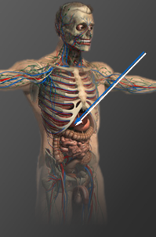
Viral Hepatitis
Virus attacks liver
Acute and chronic infections
Possible liver damage ranging from mild to fatal
The liver
  A large, dark red gland located in the upper right abdomen behind the lower ribs
  Removes waste products and foreign substances from the bloodstream
  Regulates blood sugar levels
  Creates essential nutrients
Notes:
Hepatitis viruses are very infectious organisms that attack the liver, causing inflammation of the liver and often enlargement and tenderness of the liver. Viral hepatitis infections can be acute (short-term), or some can become chronic (long-term) and last the rest of one’s lifetime. Hepatitis infection can result in liver damage that is mild, severe, or fatal. The liver is an essential organ of the body that performs over 500 vital functions. These include removing waste products and foreign substances from the bloodstream, regulating blood sugar levels, and creating essential nutrients.

Slide 13
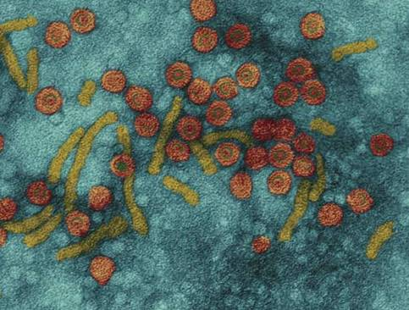
Hepatitis B
General Facts:
Hearty virus - can live for 7 days in dried blood
100 times more contagious than HIV
In 2018, an estimated 3,322 persons in the United States were newly infected with HBV
826,000 million carriers
3,000 deaths/year
No cure, but there is a preventative vaccine
Notes:
The Hepatitis B virus can survive outside the body for more than 7 days in a dry state on a surface, for instance on a countertop or discarded hypodermic needle. HBV is 100 times more contagious than HIV. The number of new infections per year is 3,322 (2018). The highest rate of disease occurs in 40–49-year-olds. There are an estimated 862,000 chronically infected Americans who are carriers. Those with chronic hepatitis infection are at higher risk for liver diseases, such as cirrhosis and liver cancer. Approximately 5000 die per year from cirrhosis or later complications such as liver cancer in the U.S. There is no cure, but there is a vaccine that can prevent you from getting infected and is effective before or after exposure.

Slide 14
Hepatitis B (Continued)
Clinical Features:
Incubation period | Average 60-90 days Range 45-180 days
No sign or symptoms Acute illness (jaundice) | 30% 30%-50% (≥5 years old)
Chronic infection (carrier) | 2%-10% (of infected adults)
- Premature death from chronic liver disease | 15-25% (of chronically infected)
Immunity | Protected from future infection
Notes:
The incubation period varies from 45 to 180 days. Onset of acute disease is generally gradual. About 30% of infected persons show no sign or symptoms. The course and outcome of HBV infection vary substantially depending on the age at which infection occurs. Clinical illness associated with acute infection is (jaundice) which occurs in 30%-50% of older children and adults. About 0.5%-1% of infected persons die from acute illness, but most acute HBV infections in adults result in complete recovery with immunity from future infection. However, up to about 10% of adults who are infected with HBV develop chronic infection and become carriers. Most of the serious consequences associated with HBV occur in these persons, who have recurring episodes of the disease for life and remain potentially infectious. Persons with chronic HBV infection often have no symptoms, but these persons are at high risk for developing chronic hepatitis B, and approximately 15%-25% may die prematurely from either cirrhosis or liver cancer. After you have a Hepatitis B infection, you are immune (protected) from any future Hepatitis B infections.

Slide 15
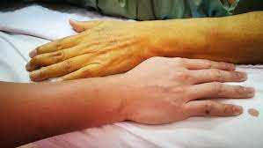
Hepatitis B (Continued)
Symptoms:
Flu-like symptoms
Fatigue
Abdominal pain
Loss of appetite
Nausea, vomiting
Joint pain
Jaundice
Notes:
Symptoms of Hepatitis B viral infection may include: 1) Fatigue; 2) Abdominal pain; 3) Loss of appetite; 4) Nausea; vomiting 5) Joint pain; 6) Jaundice. (Jaundice is a yellowing of the skin, sclera or “whites” of the eyes, and mucous membranes. It is due to an increase in bile pigments in the blood resulting from failure of the liver cells to function properly.)

Slide 16
Hepatitis B (Continued)
Transmission:
Unprotected sex with multiple partners
Sharing needles during injecting drug use
From infected mother to child during birth
Sharps/needle sticks
Notes:
HBV is spread from one person to another through blood to blood and sexual contact in blood, semen, and vaginal fluid. In the United States, the most important route of HBV transmission is by sexual contact, either heterosexual or homosexual, with multiple partners without using a condom. Sharing needles and syringes during injecting drug use is also an important mode of spread. Transmission can occur during birth from a chronically infected mother to her infant, most commonly by contact of maternal blood to the infant's mucous membranes at the time of delivery. Transmission of HBV may occur by needle sticks or other injuries from sharp instruments on the job. Other parenteral exposures, meaning a piercing through the skin, may include tattooing, ear piercing, and acupuncture. However, these exposures account for only a small proportion of reported cases in the United States. Saliva can be a vehicle of transmission through bites; however, transmission has not been documented to occur as a result of other types of exposure to saliva, including kissing. Tears, sweat, urine, feces, and breast milk have not been associated with transmission.

Slide 17
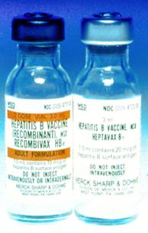
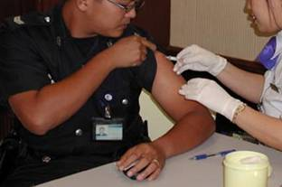
Hepatitis B (Continued)
Vaccine:
No cost to employee
3 shots: 0, 1, & 6 months
Effective for 95% of adults
Post-vaccination testing for high-risk HCW
Post-exposure treatment (if not vaccinated)
If decline, must sign Declination Form
  Vaccine available at later date if desired
Notes:
Hepatitis B vaccine is provided free of charge to all employees at risk for exposure to BBP. The vaccination consists of a series of three different shots given at 0, 1, and 6 months and is highly effective. Post-vaccination testing will be given 1-2 months after the third vaccine dose for high-risk health care workers (i.e., those who are at risk for sharps injury). If you have an exposure incident and have not been vaccinated, the treatment will usually include Hepatitis B immune globulin and the vaccination series. Post-exposure prophylaxis is more than 90% effective in preventing HBV infection. If you choose to decline the vaccination now, you must sign a Declination Statement. However, if you decide later at any time that you would like to have the Hepatitis B vaccination, it will still be available under these same conditions.

Slide 18
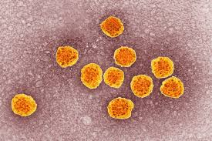
Hepatitis C
General Facts:
The most common chronic bloodborne infection in the U.S.
3.9 million (1.8%) Americans infected; 2.4 million chronically infected
57,500 new infections per year in 2019
Leading cause of liver transplantation in U.S.
No vaccine available
New medication to treat for HCV have been approved in recent years
Notes:
Hepatitis C virus (HCV) is the most common chronic bloodborne infection in the United States. An estimated 3.9 million Americans have been infected with HCV, of whom 2.4 million are chronically infected. Hepatitis C infections are increasing in the United States. HCV is responsible for 40%-60% of all chronic liver disease in the United States, and it is as important as alcohol as a cause of chronic liver disease. It is the leading indicator for liver transplant in the U.S. It is estimated that 8,000-10,000 deaths may be related to chronic HCV infection each year. There is no vaccine available currently, however, there are new medication to treat for HCV have been approved in recent years. These treatments are much better than the previously available treatment because they have few side effects and do not need to be injected.

Slide 19
Hepatitis C (Continued)
Clinical Features:
Incubation period | Average 6-7 weeks Range 2-26 weeks
No sign or symptoms Acute illness (jaundice) | 80% ≤20% (Mild)
Chronic infection Chronic liver disease | 75%-85% 10%-70% (most are asymptomatic)
Deaths from chronic liver disease | 1%-5%
Immunity | No protection from future infection identified
Notes:
The average incubation period for hepatitis C is generally 6-7 weeks. About 80% of persons having an acute infection show no signs or symptoms, with about 20% having jaundice and mild symptoms. It’s rare that death from acute liver failure from hepatitis C occurs. However; the long-term effects are that up to 85% of persons infected with HCV may develop life-long chronic infection and become carriers - these persons are at risk for developing cirrhosis and liver cancer.

Slide 20

Hepatitis C (Continued)
Symptoms:
Flu-like symptoms
Fatigue
Abdominal pain
Loss of appetite
Nausea, vomiting
Dark urine
Jaundice
Notes:
Symptoms of Hepatitis C viral infection may include: 1) Flu-like symptoms; 2) Jaundice; 3) Fatigue; 4) Dark urine; 5) Abdominal pain; 6) Loss of appetite; 7) Nausea. Remember that most people don’t have any symptoms.

Slide 21
Hepatitis C (Continued)
Transmission:
Injecting drug use
Unprotected sex with multiple partners
From infected mother to child during birth
Sharps/needle sticks
Blood transfusion and/or organ transplant before 1992 or from outside the U.S.
Notes:
HCV is spread from one person to another through blood to blood and sexual contact in blood, semen, and vaginal fluid. In the United States, the most important route of HCV transmission is by sexual contact, either heterosexual or homosexual, with multiple partners without using a condom. Sharing needles and syringes during injecting drug use is also an important mode of spread. Transmission can occur during birth from a chronically infected mother to her infant, most commonly by contact of maternal blood to the infant's mucous membranes at the time of delivery. Transmission of HCV may occur by needle sticks or other injuries from sharp instruments on the job.

Slide 22
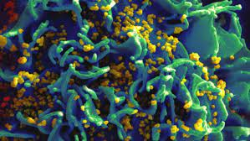
Human Immunodeficiency Virus
General Facts:
Fragile – few hours in dry environment
Attacks the human immune system
Cause of AIDS
1.2 million infected persons in U.S.
No cure; no vaccine available yet
Notes:
There are approximately 1.2 million persons infected with HIV in U.S. The Human Immunodeficiency Virus, HIV, is fragile compared to HBV. It does not survive well outside the body and can live in a dry environment for only a few hours. No one has yet been identified as infected with HIV due to contact with an environmental surface. HIV attacks your body’s ability to protect itself from disease. It destroys the human immune system by attacking certain cells known as T cells, which are part of the first line of defense that our immune system must fight infection. HIV is the cause of Acquired Immunodeficiency Syndrome, or AIDS. There are now more than one million HIV-infected persons in the US. There is no cure and no vaccine available yet.

Slide 23
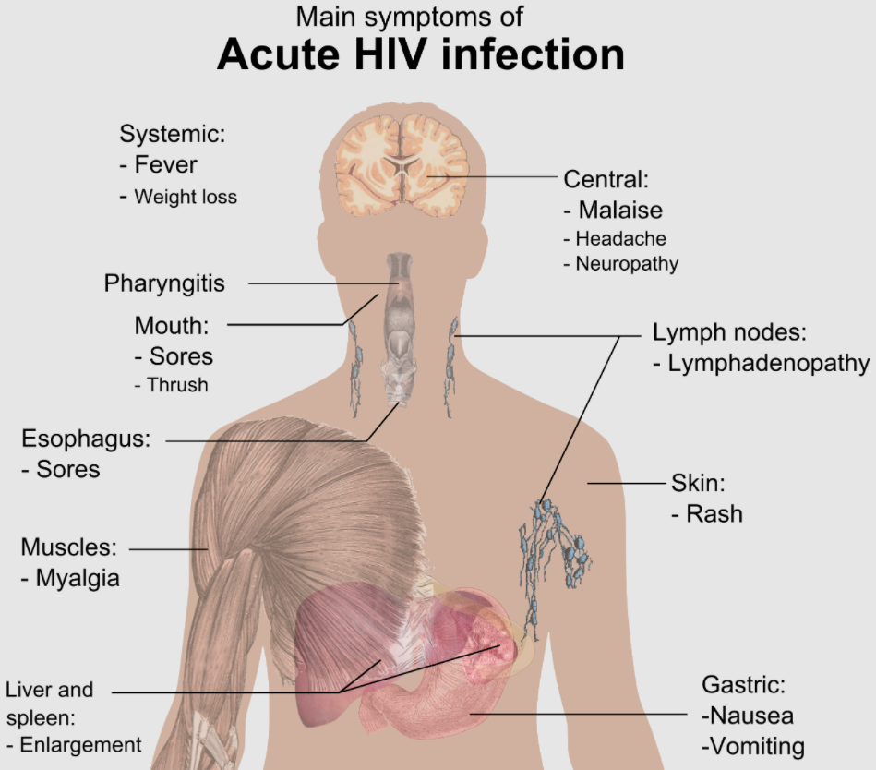
Human Immunodeficiency Virus (Continued)
Clinical Features:
Notes:
Many people who are infected with HIV do not have any symptoms at all for many years or may have mild flu-like symptoms. Most persons who become infected with HIV will eventually develop AIDS, which is the most advanced stages of the infection. There is usually a latency (inactive) period of years before the onset of AIDS after the initial infection. There are also other medical treatments that can prevent or cure some of the illnesses associated with AIDS, though the treatments do not cure AIDS itself. The only way to determine for sure whether you are infected is to be tested for HIV infection. You cannot rely on symptoms to know whether you are infected with HIV. Infection with HIV can weaken the immune system to the point that it has difficulty fighting off certain infections and cancers. These types of infections are known as "opportunistic" infection because they take the opportunity of a weakened immune system to cause illness. A healthy immune system can usually control these types of infections; however, in a person with AIDS, these opportunistic infections may be life-threatening.

Slide 24
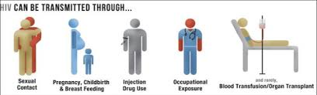
Human Immunodeficiency Virus (Continued)
Transmission:
Sexual contact
Sharing needles and/or syringes
From HIV-infected women to their babies during pregnancy or delivery
Breast-feeding
Needlesticks
Notes:
HIV is spread from one person to another through blood to blood and sexual contact in blood, semen, vaginal fluid, breast milk, and other body fluids containing blood (CSF, synovial fluid, and amniotic fluid). Transmission through transfusions of infected blood or blood clotting factors is less common and now very rare in countries where blood is screened for HIV antibodies. Needlesticks - Most occupational exposures do not result in infection.

Slide 25
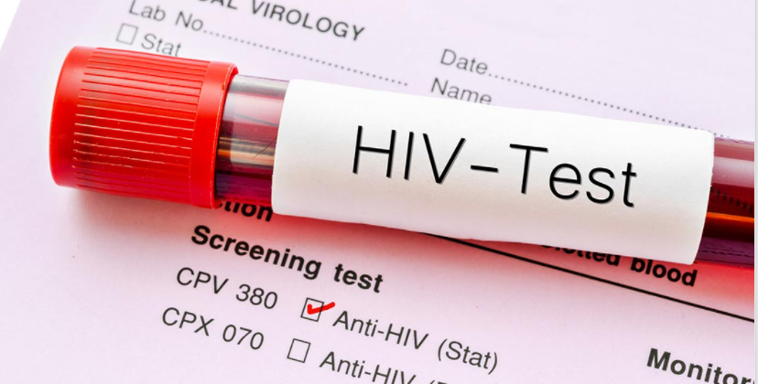
Human Immunodeficiency Virus (Continued)
Testing:
The most common HIV tests use blood
Tests using saliva or urine are also available
All positive HIV tests must be followed up by another test to confirm the positive result.
Notes:
Laboratory tests nucleic acid tests (NAT and antigen/antibody) tests require blood to be drawn from your vein into a tube and then that blood is sent to a laboratory for testing. The oral fluid tests use oral fluid (not saliva) that is collected from the mouth using a special collection device. This is an enzyme-linked immunosorbent assay (ELISA) antibody test. ELISAs rely on specific antibodies to bind the target antigen, and a detection system to indicate the presence and quantity of antigen binding. Urine tests use urine instead of blood. The sensitivity and specificity accuracy are somewhat less than that of the blood and oral fluid tests. A positive test is followed up by another test to confirm the initial positive result.

Slide 26

Human Immunodeficiency Virus (Continued)
Prevention:
Not sharing needles
Use Latex / polyurethane condoms
Preventing occupational HIV transmission to healthcare workers.
HIV screening for mother-to-child transmission
Notes:
More tools than ever are available today to prevent HIV. You can use strategies such as abstinence (not having sex), never sharing needles, and using condoms the right way every time you have sex. You may also be able to take advantage of HIV prevention medicines such as pre-exposure prophylaxis (PrEP) and post-exposure prophylaxis (PEP).

Slide 27
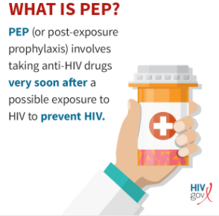
Human Immunodeficiency Virus (Continued)
Post-Exposure Prophylaxis:
Recommendations for HIV PEP include a basic 4-week regimen of two drugs
For most HIV exposures: zidovudine [AZT or ZDV] and lamivudine [3TC]; 3TC and stavudine [d4T]; or didanosine [ddI] and d4T
The drugs have demonstrated effectiveness in preventing the virus (79% or better) in those who received treatment within the initial 24 hours of exposure
Notes:
When the source person’s virus is known or suspected to be resistant to one or more of the drugs considered for the PEP regimen, the selection
of drugs to which the source person’s virus is unlikely to be resistant is recommended. PEP (post-exposure prophylaxis) means taking medicine to prevent HIV after a possible exposure. PEP should be used only in emergency situations and must be started within 72 hours after a recent possible exposure to HIV. The sooner you start PEP, the better. Every hour counts. If you’re prescribed PEP, you’ll need to take it daily for 28 days.

Slide 28
Human Immunodeficiency Virus (Continued)
Consent To Test:
KRS 214.625 - Consent for medical procedures and tests including HIV infection.
A person who has signed a general consent form for the performance of medical procedures and tests is not required to also sign or be presented with a specific consent form relating to medical procedures or tests to determine human immunodeficiency virus infection, antibodies to human immunodeficiency virus, or infection with any other causative agent of acquired immunodeficiency syndrome that will be performed on the person during the time in which the general consent form is in effect.
Notes:
Slide and In any emergency where informed consent of the patient cannot reasonably be obtained before providing health-care services, there is no requirement that a health-care provider obtain a previous informed consent.

Slide 29
Human Immunodeficiency Virus (Continued)
Confidentiality:
No person who has obtained or has knowledge of a test result pursuant to this section shall disclose or be compelled to disclose the identity of any person upon whom a test is performed, or the results of the test in a manner which permits identification of the subject of the test, except to the following persons:
  The subject's legally authorized representative;
  Any person designated in a legally effective release of the test results executed prior to or after the test by the subject of the test or the subject's legally authorized representative;
  A physician, nurse, or other health-care personnel who has a legitimate need to know the test result in order to provide for his protection and to provide for the patient's health and welfare;
  Health-care providers consulting between themselves or with health-care facilities to determine diagnosis and treatment;
  The Cabinet, in accordance with rules for reporting and controlling the spread of disease, as otherwise provided by state law;
  A parent, foster parent, or legal guardian of a minor; a crime victim; or a person specified in KRS 438.250.
Notes:
No person to whom the results of a test have been disclosed shall disclose the test results to another person except as authorized by this subsection. When disclosure is made pursuant to this subsection, it shall be accompanied by a statement in writing which includes the following or substantially similar language: "This information has been disclosed to you from records whose confidentiality is protected by state law. State law prohibits you from making any further disclosure of such information without the specific written consent of the person to whom such information pertains, or as otherwise permitted by state law. A general authorization for the release of medical or other information is NOT sufficient for this purpose." An oral disclosure shall be accompanied by oral notice and followed by a written notice within ten (10) days.

Slide 30

Human Immunodeficiency Virus (Continued)
Reporting Requirements:
By law, HIV and AIDS cases are to be reported by name to the Kentucky Department for Public Health within five (5) days of diagnosis.
  HIV/AIDS Branch (KYDPH)
  275 E. Main St. HS2E-C
  Frankfort, KY 40621
  (502) 564-6539
Notes:
By law, HIV and AIDS cases are to be reported by name to the Kentucky Department for Public Health within five (5) days of diagnosis.

Slide 31
Human Immunodeficiency Virus (Continued)
American with Disabilities Act:
Persons with HIV, symptomatic or not, have physical impairments that substantially limit one or more major life activities and are, therefore, protected by the law.
People discriminated against because they are regarded as being HIV-positive are also protected. For example, a person who was fired based on a rumor that he had AIDS, even if he did not, would be protected by the law.
The ADA protects Persons who are discriminated against because they are regarded as being HIV-positive are also protected. For example, the ADA would protect a person who is denied an occupational license or admission to a school based on a rumor or assumption that he has HIV or AIDS, even if he does not.
Notes:
An individual is considered to have a "disability" if he or she has a physical or mental impairment that substantially limits one or more major life activities, has a record of such impairment, or is regarded as having such impairment. Persons with HIV disease, either symptomatic or asymptomatic, have physical impairments that substantially limit one or more major life activities and thus are protected by the ADA. Persons who are discriminated against because they are regarded as being HIV-positive are also protected. For example, the ADA would protect a person who is denied an occupational license or admission to a school based on a rumor or assumption that he has HIV or AIDS, even if he does not.

Slide 32

Exposure Control Plan
Components:
Exposure determination
Exposure controls
Training and Hazard Communication
Hepatitis B Vaccine
Post exposure evaluation & follow-up
Recordkeeping
Notes:
The Exposure Control Plan is designed to eliminate or minimize your risk of exposure to BBPs at work. It includes policies and procedures and identifies persons or departments with specific responsibilities. You should familiarize yourselves with it and refer to the procedures to follow if an exposure incident occurs. The Exposure Control Plan contains the following elements: 1) An exposure determination to identify employees who are at risk for exposure; 2) The methods and controls we use to protect you from exposure to Bloodborne pathogens; 3) Training and Hazard Communication requirements; 4) Post-exposure evaluation and follow-up procedures if you experience an exposure incident; 5) Record keeping, including documentation of any occupational exposure incidents.

Slide 33
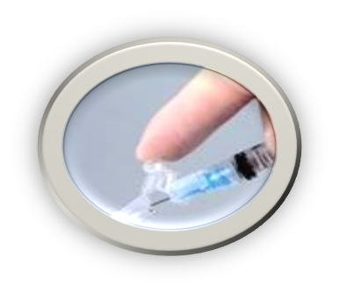

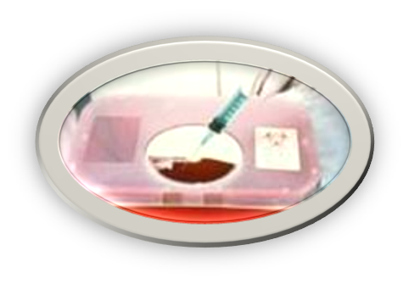
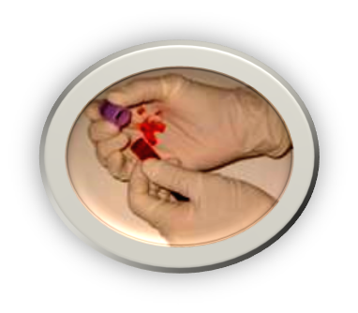
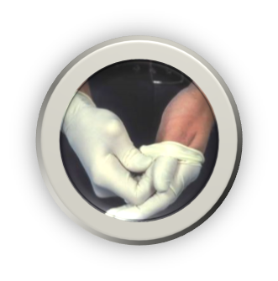
Exposure Control Plan (Continued)
Reducing Your Risk:
Universal precautions (or equivalent system)
Equipment and Safer Medical Devices
Training and Hazard Communication
Work practices
Personal protective equipment
Housekeeping
Laundry handling
Hazard communication
Regulated Waste
Notes:
The risk of occupational exposure to BBPs can be reduced or prevented by these methods, which we will discuss further: 1) Following universal precautions; 2) Using safer medical devices and equipment; 3) Following proper and safe workplace policies, practices, and procedures; 4) Using appropriate PPE when contact with blood or OPIM is expected; 5) Maintaining a clean workplace; 6) Making sure all contaminated materials are properly labeled.

Slide 34

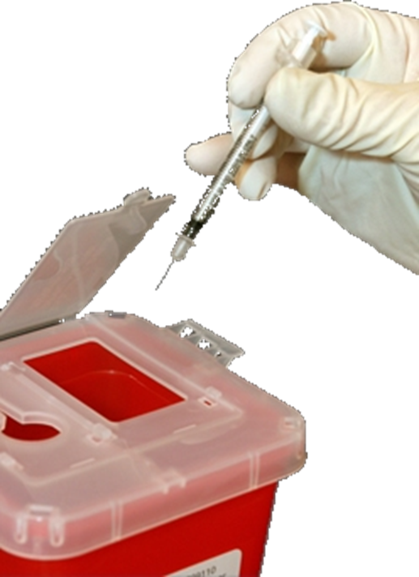
Exposure Controls
Safe Work Practices:
TREAT ALL HUMAN BLOOD AND OPIM AS IF KNOWN TO BE INFECTIOUS WITH A BLOODBORNE DISEASE
Don’t bend, recap, or remove needles or other sharps
Don’t shear or break needles
Place contaminated reusable sharps immediately in appropriate containers until properly decontaminated
Notes:
Always follow Universal Precautions. The concept of universal precautions is an infection control system that considers blood and other potentially infectious materials (OPIM) from all persons as containing a bloodborne disease, whether the person has been identified as having a bloodborne disease. Therefore, you must handle all such materials using methods that prevent or reduce the risk of exposure to yourself. Observe and follow Universal Precautions in all situations where there is a potential for contact with blood or OPIM.

Slide 35
Exposure Controls (Continued)
Safe Work Practices:
Do not pipette or suction blood or OPIM by mouth
Wash hands after each glove use and immediately or ASAP after exposure
Remove PPE before leaving work area
Do not eat, drink, smoke, apply cosmetics or lip balm, or handle contact lenses in any work areas where there is the possibility of exposure to blood or OPIM
Clean-up of spills and broken glassware/sharps contaminated with blood or OPIM
  Wear protective eyewear and mask if splashing is anticipated
  Remove glass and other sharps materials using a brush and dustpan, forceps, hemostat, etc. Do not use your hands
  Properly discard all materials into a sharps or puncture-resistant biohazardous waste container
  Use paper/absorbent towels to soak up the spilled materials
Notes:
Slide and (Clean the area with 10% bleach or EPA-registered disinfectant. Saturate the spill area with disinfectant. Leave for 10 minutes (or as specified by product manufacturer) or allow to air dry. Properly dispose of paper towels and cleaning materials into proper waste containers.)

Slide 36
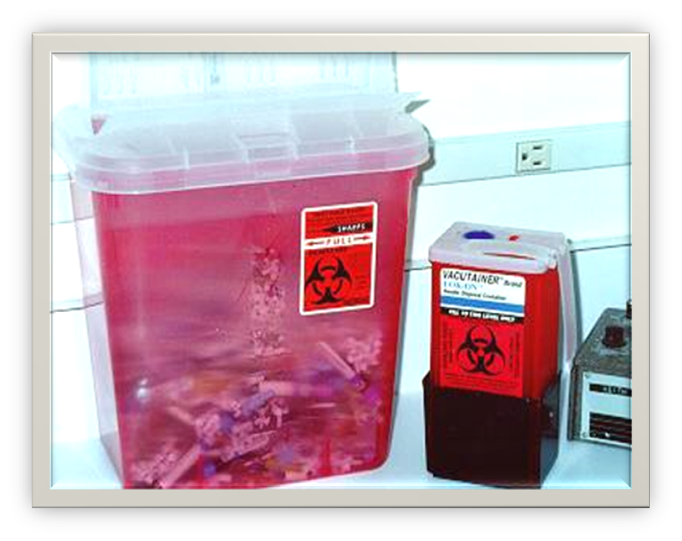
Exposure Controls (Continued)
Sharps Disposal Containers:
Closable
Puncture resistant
Leak proof
Labeled / color coded
Upright, conveniently placed in area where sharps are used
DO NOT OVERFILL!
Notes:
The use of safer medical devices and equipment will prevent or minimize your exposure to bloodborne pathogens by eliminating, removing, or isolating the BBP hazard from the work area. These include physical guards, barriers, environmental controls, or other devices. An example of a physical guard is a sharps disposal container. It must be closeable, puncture resistant, leak-proof, and labeled or color coded. During use, place them as close as feasible to the immediate area where sharps are used or anticipated to be found, keep them upright, and don’t allow them to overfill. Replace them regularly or sooner if necessary. If they need to be replaced or moved somewhere else, close them securely before you move them and place them in a larger secondary container if leakage is possible.

Slide 37
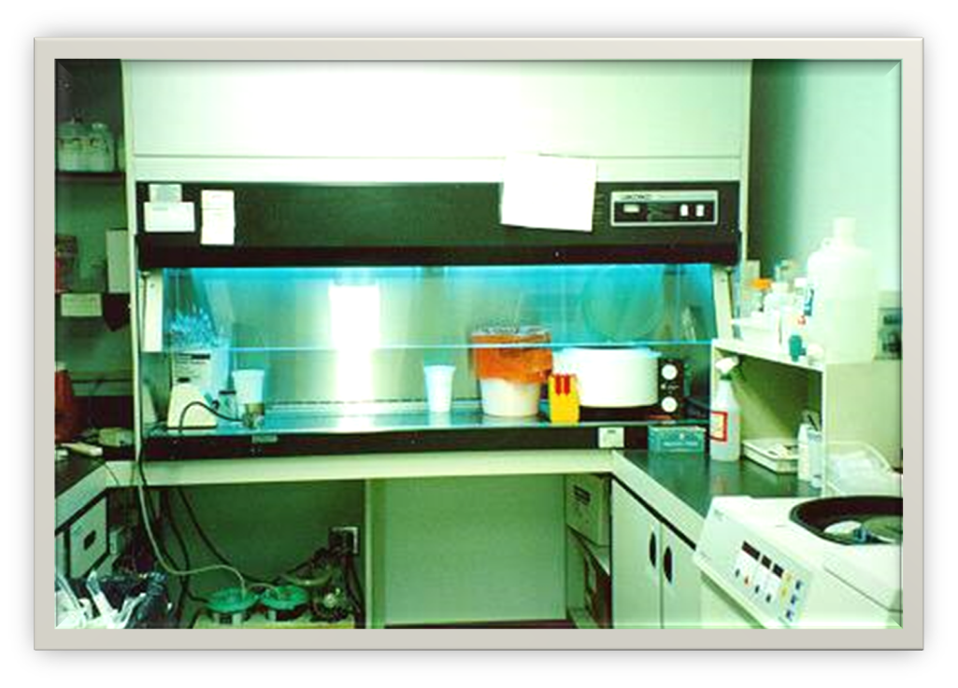
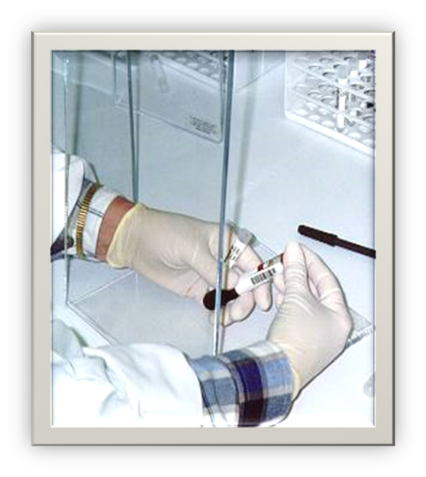
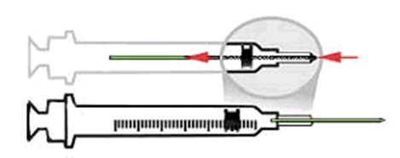
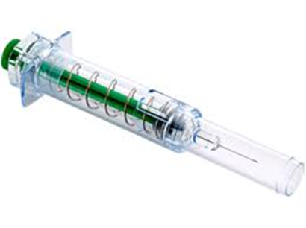
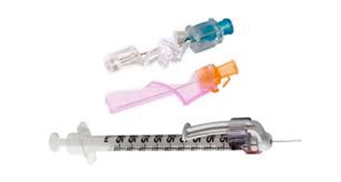
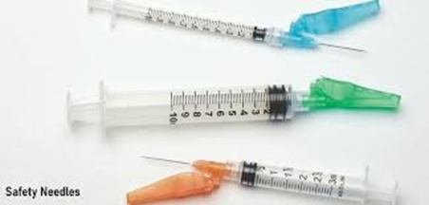
Exposure Controls (Continued)
Environmental and Engineered Controls:
Ventilation Hood
Barrier Shields
Sharps with engineered sharps injury protections (SESIP)
Needleless systems
Self-blunting needles
Plastic capillary tubes
Notes:
An environmental control may include a biological safety cabinet which combines ventilation control and a barrier. Barriers protect you by providing a shield between you and an action that could cause an aerosol or splatter. Safer medical devices have been developed to help prevent needle-stick injuries. They must be used where they can prevent or minimize occupational exposure to BBPs. Examples of safer medical devices may include: 1) Sharps with engineered sharps injury protections, or SESIP. These are non-needle sharps or needle devices that have a built-in safety feature or mechanism that reduces the risk of an exposure incident, e.g., syringes with a hinged or sliding sheath that shields the attached needle after use; needles that retract into a syringe after use; shielded or retracting catheters; IV delivery systems that use a catheter port with a needle housed in a protective covering. 2) Needle-less systems, such as an IV system or jet injection system, that do not use needles for the collection or withdrawal of body fluids or for the administration of medication or fluids. 3) Self-blunting needles: after the final tube of blood is drawn, a blunt internal hub is activated by forward pressure of the vacuum tube, blunting the needle before it is removed from the patient. 4) Plastic capillary tubes, or capillary tubes that are coated with a special film to prevent shattering.

Slide 38
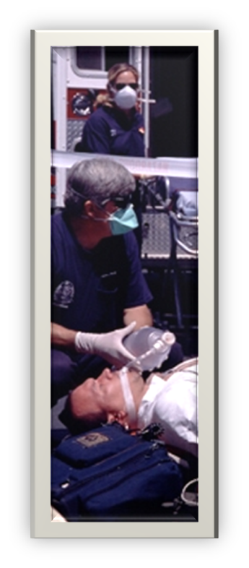
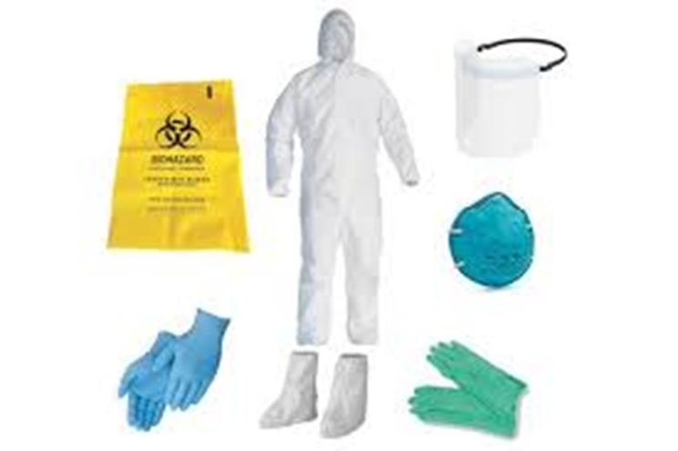
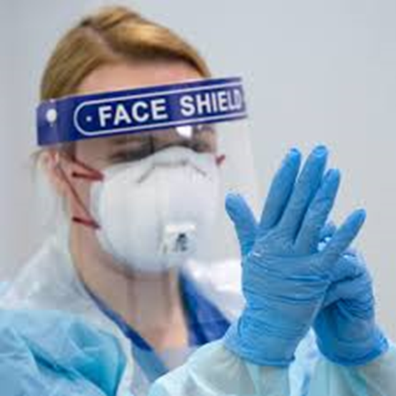
Exposure Controls (Continued)
Personal Protective Equipment (PPE):
You must wear all required PPE. Your employer is required to provide you with the necessary PPE
  Gloves – Nitrile type and utility for cleaning
  Gowns - Full body type suits
  Shoe Covers
  Face Shields and eye protection
  Resuscitation Devices
Notes:
When equipment, safer devices, and safe work practices do not eliminate exposure, the use of personal protective equipment, or PPE, is required. PPE that is “appropriate” will not permit blood or other OPIM to pass through or reach your clothes, skin, eyes, mouth, or other mucous membranes. Make sure you remove all PPE before leaving the work area. Remove contaminated PPE carefully as to avoid contact with contaminated PPE surfaces and dispose in the designated containers. Gloves must be worn when hand contact with blood or OPIM can be reasonably anticipated or when you handle or touch contaminated items or surfaces. Don’t reuse disposable gloves. Caps and/or shoe covers must be worn in instances when gross contamination can reasonably be anticipated.

Slide 39
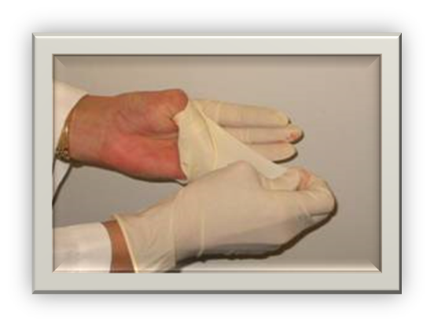
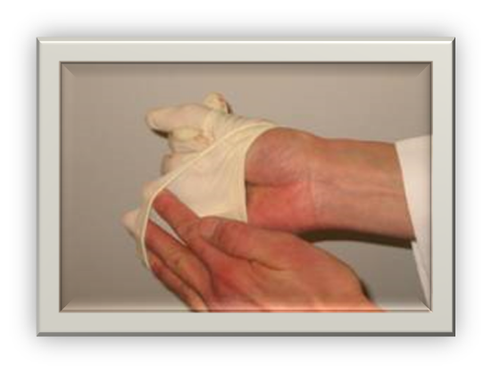
Exposure Controls (Continued)
Personal Protective Equipment (PPE):
Remove gloves safely and properly
  Grasp near cuff of glove and turn it inside out then hold in the gloved hand
  Place fingers of bare hand inside cuff of gloved hand and turn inside out and over the first glove
  Dispose gloves into proper waste container and clean hands thoroughly with soap and water or antiseptic hand rub product if handwashing facilities not available
Notes:
Make sure you remove your gloves safely and properly to avoid possible contact with blood or OPIM-contaminated gloves. Remove the glove of one hand with the other by grasping near the cuff and turning the glove inside out. Hold it in the gloved hand. Place the fingers of the bare hand inside the cuff of the gloved hand and turn that inside out and over the first glove. Dispose gloves into the proper waste container. Clean your hands thoroughly after each glove use with soap and water or use an antiseptic hand rub product (“hand sanitizers”) if hand washing facilities aren’t immediately available. If your hands are visibly contaminated and there are no washing facilities, use the antiseptic hand rub product followed by washing with soap and water as soon as possible.

Slide 40
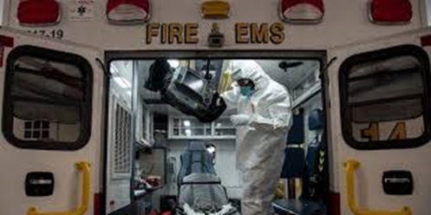

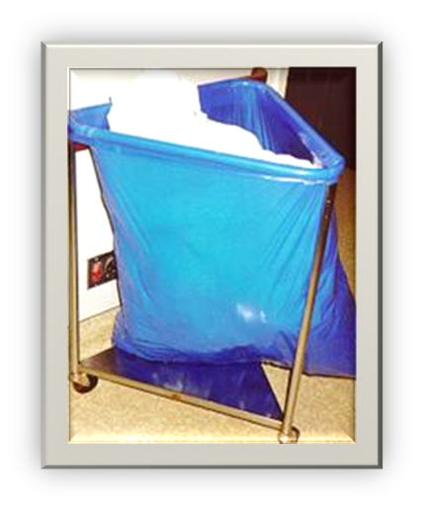
Exposure Controls (Continued)
Housekeeping:
Maintain a clean and sanitary workplace
  Written cleaning and decontamination schedule and procedures
  EPA-Approved disinfectant; Bleach
  Contaminated waste disposal methods
  Contaminated laundry: (list items that are laundered)
    Handle as little as possible
Notes:
All work areas are to be maintained in a clean and sanitary condition. A written schedule and detailed procedures for cleaning and decontamination should be established. Decontaminate all work surfaces with the appropriate disinfectant after completion of procedures, when surfaces are contaminated, and at the end of each work shift. The appropriate disinfectant is an *EPA-approved tuberculocidal or HIV/HBV-effective disinfectant, or a diluted (1:10 for spills, 1:100 for routine cleaning) bleach solution made daily. Contaminated laundry needs to handled as little as possible and bagged or containerized where it was used. Don’t sort or rinse where items were used. Containers or bags must be labeled or red color-coded. Wear the following PPE when handling and/or sorting contaminated laundry: 1) Gloves; 2) Gown; 3) Face shield.(If all soiled laundry is handled using universal precautions, then alternative, identifiable color coding may be utilized instead of labels. Laundry shipped off-site must be labeled or red color coded unless the receiving facility utilizes universal precautions for all laundry. The receiving laundry must be notified.

Slide 41
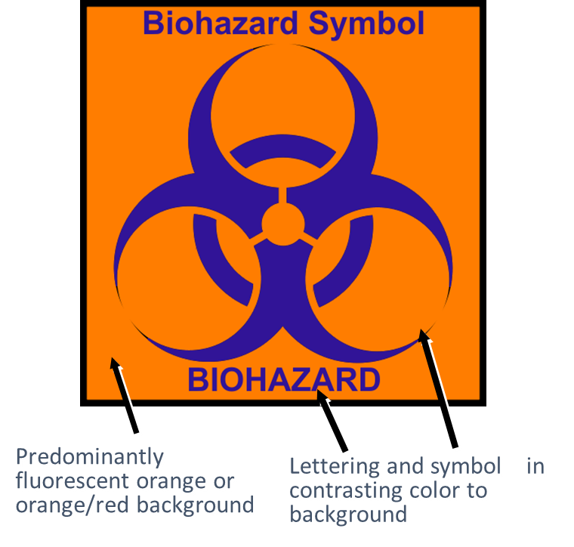
Exposure Controls (Continued)
Communication of Hazards:
Must have biohazard symbol
Labels attached securely to any containers or items containing blood/OPIM
Red bags/containers may substitute for labels
Signs posted at entrance to specified work areas
Notes:
Containers containing blood or OPIM, or equipment contaminated with blood/OPIM must have this orange/red label with the biohazard symbol. The following must be labeled: 1) Regulated waste disposal; 2)Sharps containers; 3) Containers used to store, transport or ship 4) Laundry; 5) Contaminated equipment. The labels must be attached with string, wire, adhesive, or other method so they can't become lost or accidentally removed. Red bags or red containers may be substituted for labels.

Slide 42

Exposure Controls (Continued)
Regulated Waste:
Liquid or semi-liquid blood or OPIM
Contaminated items that would release blood or OPIM in a liquid or semi-liquid state if compressed
Items caked with dried blood or OPIM that can release these materials during handling
Contaminated sharps
Biological waste containing blood or OPIM
Notes:
Regulated waste is one that poses a significant risk of exposure to workers, including those who may handle the waste downstream. Regulated waste include: 1) Liquid or semi-liquid blood or OPIM; 2) Contaminated items that would release liquid or semi-liquid blood or OPIMs if compressed or compacted; 3) Dried caked blood or OPIM that might flake off or be released if handled; 4) Contaminated sharps and pathological and biological items or waste with blood or OPIMs. This does not include materials that sufficiently absorb blood or OPIM. For example, band aids and feminine hygiene products are not regulated waste. All contaminated waste must be handled in a sanitary manner. Waste containers must be lined and regularly disinfected.

Slide 43

Exposure Incident
If You Have An Exposure Incident To Blood Or OPIM, Immediately Do The Following:
Thoroughly clean the affected area
  Wash needlesticks, cuts, and skin with soap and water
  Flush with water splashes to the nose and mouth
  Irrigate eyes with clean water, saline, or sterile solutions
  Report exposure to supervisor present at scene or during time of exposure; fill out an Incident Report Form
Notes:
Slide and In the Incident Report Form, try to describe the exposure event in as much detail as possible and submit the report to any Line Officer present at time of exposure.

Slide 44
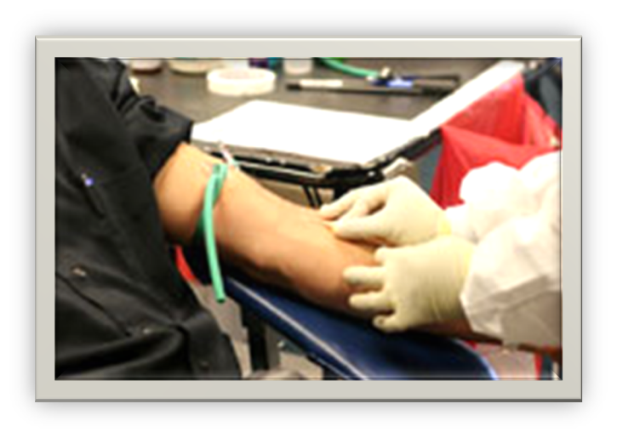
Post-Exposure Evaluation
Employer’s Responsibility:
Provide immediate post-exposure medical evaluation and follow-up to exposed employee:
  At no cost
  Confidential
  Testing for HBV, HCV, HIV
  Preventive treatment when indicated
  Test blood of source person if HBV/HCV/HIV status unknown, if possible; provide results to exposed employee, if possible
Notes:
Medical evaluation must be provided as soon as possible. Even though there is no clear recommendation as to how soon HIV post-exposure prophylaxis (PEP) must be given to be effective, most health care professionals recommend the HIV PEP be given within hours after exposure. The is no evidence that HIV PEP is effective if given longer than 24 hours after exposure. HBV immune globulin may be given within 7 days after exposure but is most effective given as soon as possible after exposure. There is no post-exposure preventative medicine that is available for HCV.

Slide 45
Post-Exposure Evaluation (Continued)
Employer’s Responsibility:
Provide exposed employee with copy of the evaluating health care professional’s (HCP) written opinion within 15 days of completion of evaluation
Provide employee with information about laws on confidentiality for the source individual
Provide post-exposure treatment as needed, including counseling
Notes:
Slide

Slide 46

Recordkeeping
Medical and Training:
Medical
  Confidential
  Hepatitis B vaccination and post-exposure evaluations
  HCP’s written opinions
  Information provided to HCP as required
  Maintain for length of employment 30+ years
Training
  Dates
  Content summary
  Trainer name and qualifications
  Attendee’s names and job titles
  Maintain for 5 years
Notes:
Slide

Slide 47
HIV-AIDS Attitude and Behavior
Education:
HIV-AIDS induced stigma and discrimination results from a lack of education and understanding the facts of HIV-AIDS
  HIV-AIDS stigma drives acts of discrimination in all sectors of society, including health care, education, the workplace, the justice system, families, and communities
  Breaking down HIV-AIDS stigma is a critical part of ending the HIV epidemic
  Educate others to correct myths and stereotypes about HIV-AIDS
  Keep up to date on the latest HIV-AIDS:
    Statistics
    Prevention
    Treatment
    Testing
Notes:
HIV-AIDS induced stigma and discrimination results from a lack of education and understanding the facts of HIV-AIDS. Stigma refers to irrational or negative attitudes, behaviors, and judgments towards people with HIV–AIDS. HIV-AIDS stigma drives acts of discrimination in all sectors of society, including health care, education, the workplace, the justice system, families, and communities. Help reduce HIV-AIDS stigma and discrimination by educating others to correct myths and stereotypes about HIV-AIDS. You can best accomplish this by keeping up to date on the latest HIV-AIDS statistics, prevention, treatment and testing found at CDC.GOV. Thank you for taking the time to complete the KBEMS HIV/AIDS education for EMS providers.

Slide 48

Questions?
Please refer all questions to:
  Robert G. Andrew, II
  Director of Education & Training
  Kentucky Board of Emergency Medical Services
  2464 Fortune Drive, Suite 195
  Lexington, KY 40509
  (859) 256-3577
  robert.andrew@kctcs.edu
Notes:
Please refer all questions to:
Robert G. Andrew, II
Director of Education & Training
Kentucky Board of Emergency Medical Services
2464 Fortune Drive, Suite 195
Lexington, KY 40509
(859) 256-3577
robert.andrew@kctcs.edu

