Slide 1
Understanding Abusive Head Trauma:
A Program for First Responders
Melissa L. Currie, MD, FAAP
Chief, Norton Children’s Pediatric Protection Specialists
Kosair Charities Professor and Endowed Chair for Pediatric Forensic Medicine
University of Louisville School of Medicine
Board-Certified Child Abuse Pediatrician

Slide 2
Objectives
  Define and describe abusive head trauma and its associated injuries
  Review statistics of abusive head trauma
  Understand the medical evaluation and follow-up of a child with abusive head trauma
  Discuss some case scenarios
  Discuss prevention strategies

Slide 3

The Evolution of Terminology
  Nonaccidental trauma
  Inflicted neurotrauma
  Inflicted head injury
  Shaken Baby Syndrome
  Shaken-Impact Syndrome
  Abusive Head Trauma
Preferred terminology
since 2009

Slide 4

Why not “Shaken Baby Syndrome”?
  This type of inflicted injury is not limited to babies—it is seen regularly in children who are 2, 3, even 4 years of age. There have been reports of children as old as 8 years who have died from this form of abuse.
  We know from decades of research that often, the mechanism of injury for abusive head trauma is not limited to shaking alone. In some (but certainly not all) cases, impact and other mechanisms can also be involved.
Notes:
Since many children who have head injuries from abuse have a combination of shaking and impact, we have learned that it is helpful not to limit ourselves to only one mechanism of injury (shaking.) Sadly, these children have often had a variety of mechanisms of injury, including shaking, blows to the head, and being slammed into hard or soft surfaces (like walls or couches.)

Slide 5
Kentucky Statistics…
  On average (FYE 2016-2020), 72 (60-85) children die under circumstances of maltreatment each year in KY.
  Additionally, on average (FYE 2016-2020), 89 (73-120) children are involved in near fatal incidents each year.
  Near fatality = An act which, as certified by a physician, results in a child being in serious or critical condition.
  Kentucky is consistently among the worst states for child victimization rate, with more than double the national average.
2021 Annual Report of Child Fatality & Near Fatality Review Panel. http://justice.ky.gov/Pages/Reports.aspx
NCANDS/Children’s Bureau. Child Maltreatment 2019. https://www.acf.hhs.gov/cb/report/child-maltreatment-2019

Slide 6
Incidence/Prevalence
  Abusive head trauma is the most common cause of morbidity (disability) and mortality (death) in physical child abuse.
  Abusive head trauma usually occurs in children younger than 1 year of age, but older children can be victims as well.
  It is the most common cause of death from brain injury in children less than one year of age.

Slide 7
  It is rare for a child to die from
  or to be
  permanently disabled from maltreatment
  the first time they are abused/neglected.
Notes:
This means that we often have the opportunity to recognize early signs of maltreatment and to intervene before it escalates.

Slide 8
Reporting Requirements
  KRS 620.030 Duty to report
    Any person who knows or has reasonable cause to believe that a child is neglected or abused shall immediately cause an oral or written report to be made to
      A local law enforcement agency or Department of KY State Police
      The cabinet or its designated representative (CHFS/DCBS)
      The Commonwealth’s attorney or the county attorney
    Any supervisor who receives from an employee a report of suspected dependency, neglect, or abuse shall promptly make a report to proper authorities for investigation
Notes:
(1) Any person who knows or has reasonable cause to believe that a child is dependent, neglected, or abused shall immediately cause an oral or written report to be made to a local law enforcement agency or the Department of Kentucky State Police; the cabinet or its designated representative; the Commonwealth's attorney or the county attorney; by telephone or otherwise. Any supervisor who receives from an employee a report of suspected dependency, neglect, or abuse shall promptly make a report to the proper authorities for investigation. If the cabinet receives a report of abuse or neglect allegedly committed by a person other than a parent, guardian, or person exercising custodial control or supervision, the cabinet shall refer the matter to the Commonwealth's attorney or the county attorney and the local law enforcement agency or the Department of Kentucky State Police. Nothing in this section shall relieve individuals of their obligations to report.
(2) Any person, including but not limited to a physician, osteopathic physician, nurse, teacher, school personnel, social worker, coroner, medical examiner, child-caring personnel, resident, intern, chiropractor, dentist, optometrist, emergency medical technician, paramedic, health professional, mental health professional, peace officer, or any organization or agency for any of the above, who knows or has reasonable cause to believe that a child is dependent, neglected, or abused, regardless of whether the person believed to have caused the dependency, neglect, or abuse is a parent, guardian, person exercising custodial control or supervision, or another person, or who has attended such child as a part of his or her professional duties shall, if requested, in addition to the report required in subsection (1) or (3) of this section, file with the local law enforcement agency or the Department of Kentucky State Police or the Commonwealth's or county attorney, the cabinet or its designated representative within forty-eight (48) hours of the original report a written report containing:
(a) The names and addresses of the child and his or her parents or other persons exercising custodial control or supervision;
(b) The child's age;
(c) The nature and extent of the child's alleged dependency, neglect, or abuse, including any previous charges of dependency, neglect, or abuse, to this child or his or her siblings;
(d) The name and address of the person allegedly responsible for the abuse or neglect; and
(e) Any other information that the person making the report believes may be helpful in the furtherance of the purpose of this section.

Slide 9
Reporting Requirements
  KRS 620.030 Duty to report
    Any person, including but not limited to a physician, osteopathic physician, nurse, teacher, school personnel, social worker, coroner, medical examiner, child-caring personnel, resident, intern, chiropractor, dentist, optometrist, EMT, paramedic, health professional, mental health professional, peace officer, or any organization or agency for any of the above…
    In addition to the initial report, must file with the local law enforcement agency, state police, DCBS, or state/county attorney within 48 hours, a written report containing additional details – names, age, addresses, nature and extent of allegations, any other pertinent info
Notes:
(1) Any person who knows or has reasonable cause to believe that a child is dependent, neglected, or abused shall immediately cause an oral or written report to be made to a local law enforcement agency or the Department of Kentucky State Police; the cabinet or its designated representative; the Commonwealth's attorney or the county attorney; by telephone or otherwise. Any supervisor who receives from an employee a report of suspected dependency, neglect, or abuse shall promptly make a report to the proper authorities for investigation. If the cabinet receives a report of abuse or neglect allegedly committed by a person other than a parent, guardian, or person exercising custodial control or supervision, the cabinet shall refer the matter to the Commonwealth's attorney or the county attorney and the local law enforcement agency or the Department of Kentucky State Police. Nothing in this section shall relieve individuals of their obligations to report.
(2) Any person, including but not limited to a physician, osteopathic physician, nurse, teacher, school personnel, social worker, coroner, medical examiner, child-caring personnel, resident, intern, chiropractor, dentist, optometrist, emergency medical technician, paramedic, health professional, mental health professional, peace officer, or any organization or agency for any of the above, who knows or has reasonable cause to believe that a child is dependent, neglected, or abused, regardless of whether the person believed to have caused the dependency, neglect, or abuse is a parent, guardian, person exercising custodial control or supervision, or another person, or who has attended such child as a part of his or her professional duties shall, if requested, in addition to the report required in subsection (1) or (3) of this section, file with the local law enforcement agency or the Department of Kentucky State Police or the Commonwealth's or county attorney, the cabinet or its designated representative within forty-eight (48) hours of the original report a written report containing:
(a) The names and addresses of the child and his or her parents or other persons exercising custodial control or supervision;
(b) The child's age;
(c) The nature and extent of the child's alleged dependency, neglect, or abuse, including any previous charges of dependency, neglect, or abuse, to this child or his or her siblings;
(d) The name and address of the person allegedly responsible for the abuse or neglect; and
(e) Any other information that the person making the report believes may be helpful in the furtherance of the purpose of this section.

Slide 10
Reporting Requirements
  KRS 620.030 Duty to report
    Suspicions of human trafficking must also be reported
    Spousal privilege does not apply
    Professional-client/patient privilege does not apply
    Exceptions - attorney-client or clergy-penitent privilege
Notes:
(3) Any person who knows or has reasonable cause to believe that a child is a victim of human trafficking as defined in KRS 529.010 shall immediately cause an oral or written report to be made to a local law enforcement agency or the Department of Kentucky State Police; or the cabinet or its designated representative; or the Commonwealth's attorney or the county attorney; by telephone or otherwise. This subsection shall apply regardless of whether the person believed to have caused the human trafficking of the child is a parent, guardian, or person exercising custodial control or supervision.
(4) Neither the husband-wife nor any professional-client/patient privilege, except the attorney-client and clergy-penitent privilege, shall be a ground for refusing to report under this section or for excluding evidence regarding a dependent, neglected, or abused child or the cause thereof, in any judicial proceedings resulting from a report pursuant to this section. This subsection shall also apply in any criminal proceeding in District or Circuit Court regarding a dependent, neglected, or abused child.
(5) The cabinet upon request shall receive from any agency of the state or any other agency, institution, or facility providing services to the child or his or her family, such cooperation, assistance, and information as will enable the cabinet to fulfill its responsibilities under KRS 620.030, 620.040, and 620.050.
(6) Any person who intentionally violates the provisions of this section shall be guilty of a:
(a) Class B misdemeanor for the first offense;
(b) Class A misdemeanor for the second offense; and
(c) Class D felony for each subsequent offense.
Effective: June 25, 2013
History: Amended 2013 Ky. Acts ch. 25, sec. 2, effective June 25, 2013. -- Amended 2008 Ky. Acts ch. 72, sec. 4, effective July 15, 2008. -- Amended 2007 Ky. Acts ch. 85, sec. 330, effective June 26, 2007. -- Amended 1988 Ky. Acts ch. 258, sec. 2, effective July 15, 1988; and ch. 350, sec. 43, effective April 10, 1988. -- Created 1986 Ky. Acts ch. 423, sec. 64, effective July 1, 1987.
Legislative Research Commission Note. The 1988 amendments to this section are effective April 10, 1988, except for the second sentence of subsection (1), which is effective July 15, 1988.

Slide 11
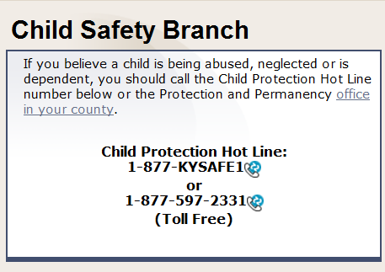

Slide 12
Protective Custody
  Emergency Custody Orders by the Court
  Law enforcement protective custody, must request ECO within 12 hours
  Physicians and hospital administrators may hold a child (in imminent danger) without a court order but must request ECO asap, not to exceed 72 hours
Notes:
See page 10 of the KY Child Abuse and Neglect Booklet
WHO CAN REMOVE CHILDREN FROM THEIR HOMES?
An emergency custody order (ECO) must be obtained from the Court any time a child is
removed from his or her home. An ECO may be requested in the following situations as defined
by statue:
(1) The court for the county where the child is present may issue an ex parte
emergency custody order when it appears to the court that removal is in the best
interest of the child and that there are reasonable grounds to believe, as
supported by affidavit or by recorded sworn testimony, that one (1) or more of the
following conditions exist and that the parents or other person exercising
custodial control or supervision are unable or unwilling to protect the child;
(a) The child is in danger of imminent death or serious physical injury or is
being sexually abused;
(b) The parent has repeatedly inflicted or allowed to be inflicted by other than
accidental means physical injury or emotional injury. This condition shall
not include reasonable and ordinary discipline recognized in the
community where the child lives, as long as reasonable and ordinary
discipline does not result in abuse or neglect as defined in KRS
600.020(1); or
(c) The child is in immediate danger due to the parent's failure or refusal to
provide for the safety and needs of the child. KRS 620.060(1).
KRS 620.040(5)(c) states:
Any appropriate law enforcement officer may take a child into protective custody and
may hold that child in protective custody without the consent of the parent or other
person exercising custodial control or supervision, if there exist reasonable grounds for
the officer to believe that the child is in danger of imminent death or serious physical
injury or is being sexually abused and that the parents or other person exercising
custodial control or supervision are unable or unwilling to protect the child. The officer or
the person to whom the officer entrusts the child shall, within twelve (12) hours of taking
the child into such protective custody, request the court to issue an emergency custody
order.
72-HOUR HOLD BY PHYSICIANS AND HOSPITAL ADMINISTRATORS
Although medical personnel may not take children into protective custody, they do have the right
to hold a child whom they feel is in imminent danger.
KRS 620.040(5)(b) states:
If a child who is in the hospital or under the immediate care of a physician appears to be in
imminent danger if he is returned to the persons having custody of him, the physician or
hospital administrator may hold a child without court order provided that a request is made
to the court for an emergency custody order at the earliest practicable time, not to exceed
seventy-two (72) hours.

Slide 13
Abusive Head Trauma: What is it, exactly?
  Brain injury
  Involves shaking, impact or both
  Can see subdural hematomas, retinal hemorrhage, scalp bruising, skull fracture…but it’s the injury to the brain tissue itself that causes death and disability
  Often triggered by crying
  In toddlers, often triggered by toilet training accidents
  It is not typically a one-time event.
Notes:
Explain that drawings are coming up to help explain this.

Slide 14
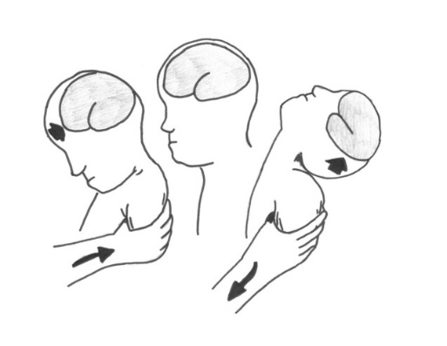
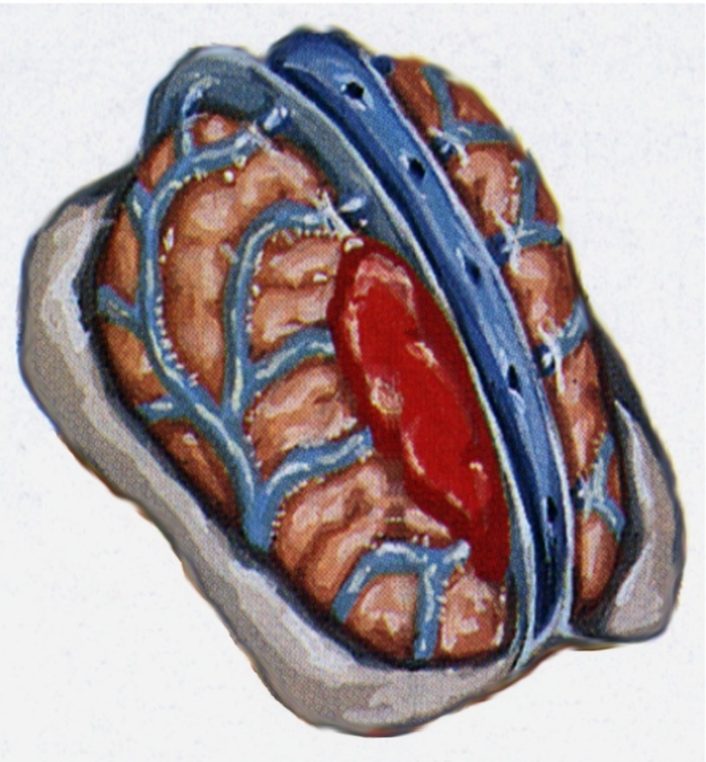
How does shaking cause injury?
  Bridging veins stretch, rupture, and bleed, leading to subdural bleeding.
  Brain tissue is distorted/stretched during the event, causing damage to nerve cells and brain tissue (either temporary or permanent damage).
  Subdural bleeding is visible on CT scan.
Notes:
NOTE: CAT scan is CT scan.
What Happens Inside the Brain During Shaking? Ask participants to make a fist, representing a baby’s brain. Ask them to take other hand and place on top of the fist, representing the skull covering the brain. Now rotate the fisted hand inside the open hand to simulate what happens when a baby is violently shaken.
Illustrate with fists how the two upper hemispheres of the brain rotate independently of each other during shaking. If you hold your fists together with fingers touching, that looks like the two hemispheres. Instruct the group to consider how the brain becomes damaged as it is stretched and distorted. The bleeding seen from a subdural hematoma is a symptom, indicating how the damage occurred. The actual motion causes the damage by distorting the brain cells which then causes them to die. Additionally, as each brain cell dies, it secretes enzymes which then damage adjacent cells.
Alternative Illustrations:
Brain Shaped Gelatin
Preparation:
At least one evening prior to training prepare gelatin using the instructions for grey or flesh tone preparation which accompany the brain mold (can be purchased at www.quiggle.com or borrowed from PCAK). Remove the gelatin brain from the mold and have available in a clear glass bowl or dish. To create a consistency more like that of an infant’s brain, allow the jello to sit out for multiple hours prior to using in the demonstration.
Demonstration:
Walk with the brain to show how the brain moves normally within the skull. Next, gently jiggle the brain to show how it begins to move with greater force/speed. Continue to shake the brain more vigorously, describing what happens to the gelatin as the motion intensifies and it begins to slide around in the container. Place a top on the container (clear plastic wrap will work) and violently shake the brain to show how it begins to separate as it hits the sides of the container.
Egg in Jar
Preparation:
Prior to the presentation, but onsite at the training location, gently break an egg into a small glass jar. A small baby food jar or clear plastic food container work well. Be careful to keep the yoke intact. Place the lid on the jar tightly and discard the shell.
Demonstration:
Introduce the container as the baby’s skull. Explain the yolk is the brain, the fluid around the yolk is the fluid around the brain. In a baby’s brain there is a lot of room between it and the skull. The consistency of the brain is like soft set jello. Simulate carrying the baby, rocking the baby (container). Also demonstrate that normal jostling does not cause the egg to break. Shake the jar slowly at first to create a crack and oozing. The increase the intensity of the shaking. Using a volunteer to do the demonstration for you can also be very effective.
Tell the group when we shake the container, the way the container looks on the outside does not change, even though the egg inside is damaged. When we shake a baby, the way the baby looks on the outside usually does not change, but he baby’s brain on the inside of the skull is damaged.

Slide 15
Why are babies at such high risk?
  Inside of the infant skull is smoother—fewer ‘nooks and crannies’ to hold the brain in place
  More space between outside of brain and inside of skull
  Relatively large head:body ratio and weak neck muscles
  Not as much myelin around the individual nerve cells
  Infant brain—25% more water than adult (think under-set gelatin)
Notes:
There are anatomical reasons that infants are at higher risk of severe injury from these types of traumatic forces.

Slide 16
American Academy of Pediatrics
  “The act of shaking leading to shaken baby syndrome is so violent that individuals observing it would recognize it as dangerous and likely to kill the child.”**
  **Shaken Baby Syndrome: Rotational Cranial Injuries—Technical Report. AAP Committee on Child Abuse and Neglect. Pediatrics. July 2001.
Notes:
Optional: Demonstration A (What Perpetration Might Look Like): Show video of a shaken baby demonstration or using a doll or stuffed animal show what it would look like to shake a child with the level of violence necessary to cause PAHT.

Slide 17
Possible Associated Injuries…
  Retinal hemorrhages
  Rib fractures/other fractures
  Bruising
  Internal abdominal injury (won’t necessarily see bruising!)
  OR NOTHING

Slide 18
Key Issues
  Infants with abusive head injury may look completely normal/uninjured from the outside.
  The signs and symptoms can be vague and easily mistaken for a more benign problem.
  Therefore, abusive head trauma is sometimes missed and/or misdiagnosed by medical professionals.
  EMTs and First Responders are in unique positions to help recognize and intervene in these cases!

Slide 19
How PAHT can present…
  Infants with bruises
  Enlarging head (out of proportion to body)
  Vomiting without diarrhea
  Irritability/extreme fussiness/“colicky”
  Lethargy, unusual sleepiness, poor responsiveness, or seeming “spaced out”
  Seizures/tremors
Notes:
Illustration: To point out why it is so unusual to see bruising on babies—ask the audience to take one hand and squeeze the other hand as hard as possible. Consider how much force it takes and there still is no bruising.

Slide 20
How PAHT can present…
  Sudden limpness/loss of tone
  Breathing difficulty/gasping for breath/stopped breathing
  Brief Resolved Unexplained Event (BRUE)
  Incidental finding (occult injury)
  Bright red blood from the mouth of infants (distinguish from blood mixed with vomit)
  Torn frenulum
Notes:
Illustration: To point out why it is so unusual to see bruising on babies—ask the audience to take one hand and squeeze the other hand as hard as possible. Consider how much force it takes and there still is no bruising.

Slide 21
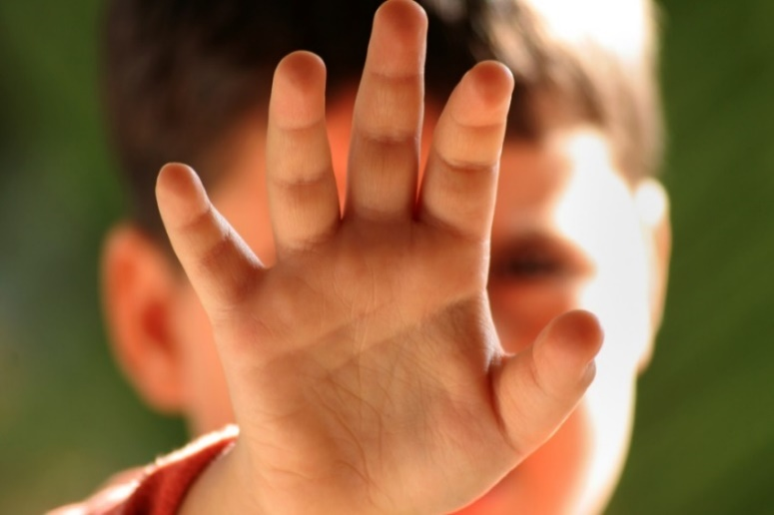
Photograph Warning
Some of the following photographs are graphic and disturbing, as they depict injuries in young children.
If this material is a trigger for you, please do what you need to do to take care of yourself.
Notes:
Instructors: When creating handouts for participants, please remove pictures. They are to be used during the presentation only.
Explain to the audience the pictures are “non-identified”, but out of respect to the child, hard copies do not include pictures.

Slide 22
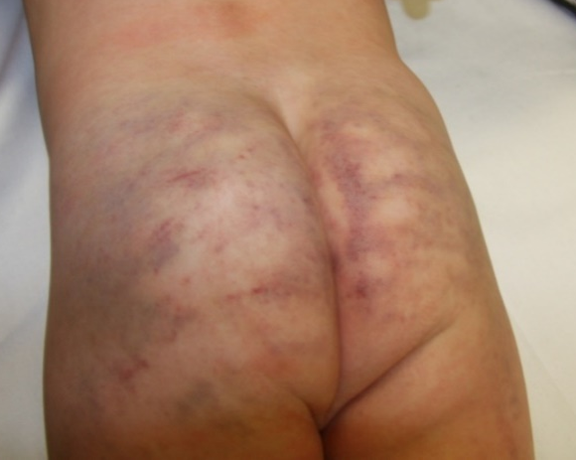
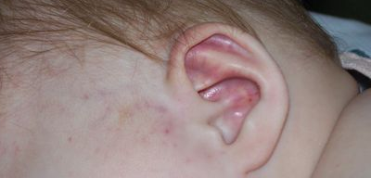
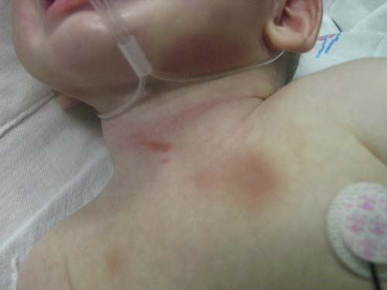
TEN-4-FACESp BRUISING RULE
ANY bruising of the
TORSO
EARS
or
NECK
in a child 4 years of age or younger
OR
ANY bruising, ANYWHERE,
on an infant who is
not independently mobile (or less than 4.99 months)
FACESp
Frenulum
Angle of the jaw
Cheeks (fleshy)
Eyelids
Subconjunctivae
Patterned
Pierce et al. Validation of a Clinical Decision Rule to Predict Abuse in Young Children Based on Bruising Characteristics. JAMA Network Open. 2021;4(4):e215832. doi: 10.1001/jamanetworkopen.2021.5832
Notes:
As mentioned in the objectives, bruising is one of the most easily recognizable forms of child physical abuse, and it’s also the most commonly missed. We all know that mobile, active children can get accidental bruises. This rule helps us determine when to be worried about bruising we might see on children. One important thing to recognize here: this is a screening tool, not a diagnostic tool. In other words, if a bruise screens positive for this rule, it means the child needs to have additional medical evaluation, but it does not necessarily mean the finding is definitive for abuse.
Torso includes chest, back, abdomen, buttocks, and genital area.
This top left photo is an example of torso bruising and is classic for multiple blows with an open hand. Note the parallel, linear contusions that conform to the contours of the body.
Ears includes any part of the ear. Sadly, this 7 month old baby was kicked in the head and had bleeding inside her skull from the impact (in addition to the ear bruising visible from the outside.)
The neck bruising in the bottom picture is in a 4 month old boy who was violently shaken, so he was a victim of abusive head trauma. Notice the bruises under his chin and on his chest. He survived, but has severe developmental problems.

Slide 23
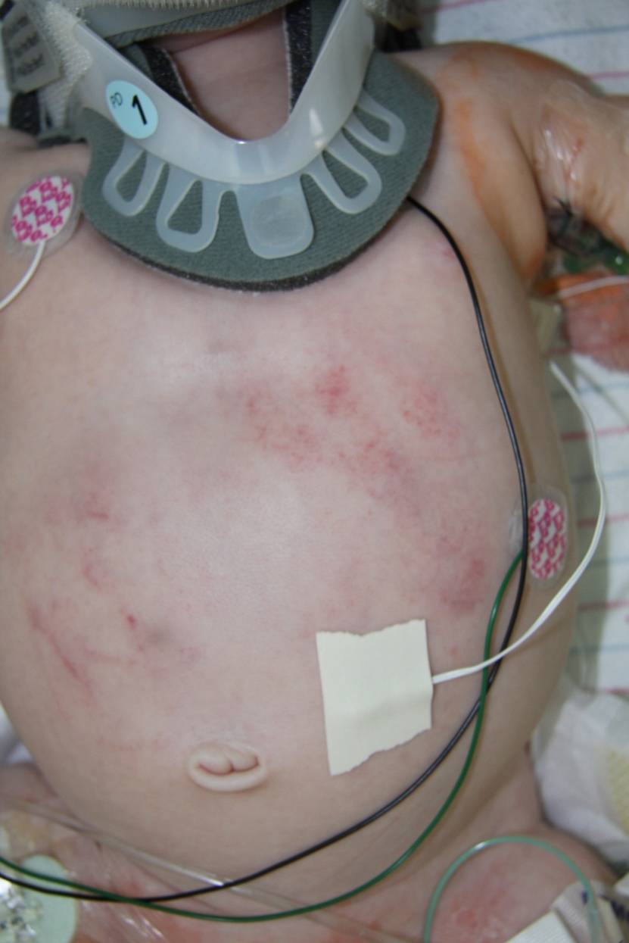
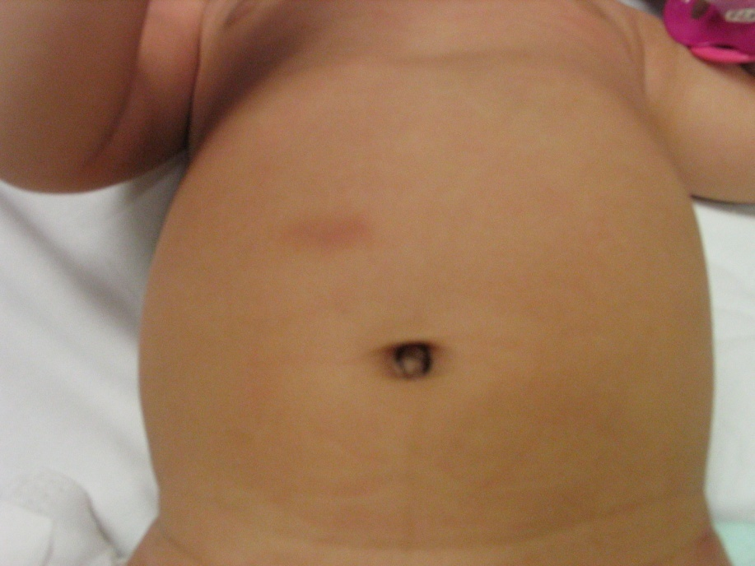
TORSO
Notes:
The baby on the left was 9 months old when she was brought in by her mother with unexplained bruising after being left with mom’s boyfriend for the first time. She was happy, playful, sucking on her pacifier (see upper right part of picture.) Because this was torso bruising, this child got a complete medical evaluation, which included labs, x-rays, and a CT scan of her head.
Screening labs showed that her liver enzyme levels were many times higher than normal. She had a tear in her liver, but we would have never known it if we hadn’t done the labs due to the single little bruise on her belly.
The baby on the right was discovered in his crib after police were called by neighbors to respond to a domestic violence call. Luckily, the social worker who went with police on the call did a “skin check” on the infant and discovered these bruises on his belly as well as finding that he was not responding to her undressing him. He had liver and pancreas injury, required emergency surgery, and without question would have died without medical care. The neighbor who called the police saved his life, as did the social worker who did a thorough wellness check on him.

Slide 24
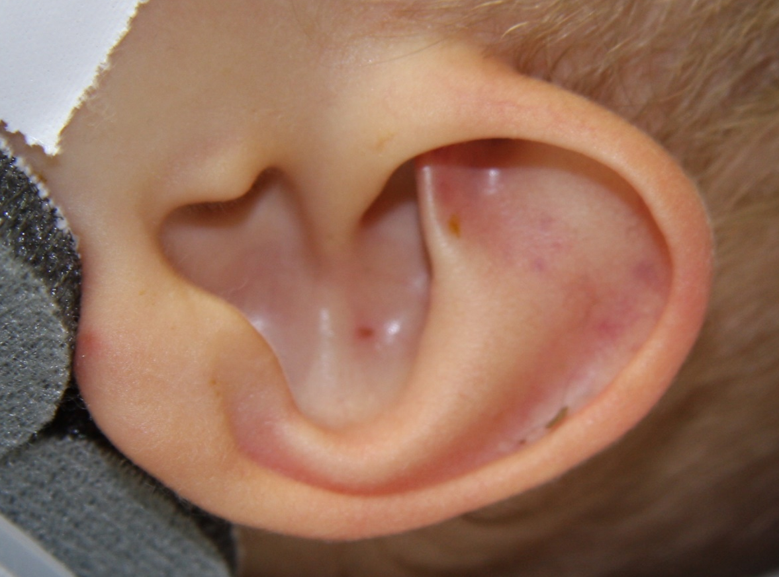
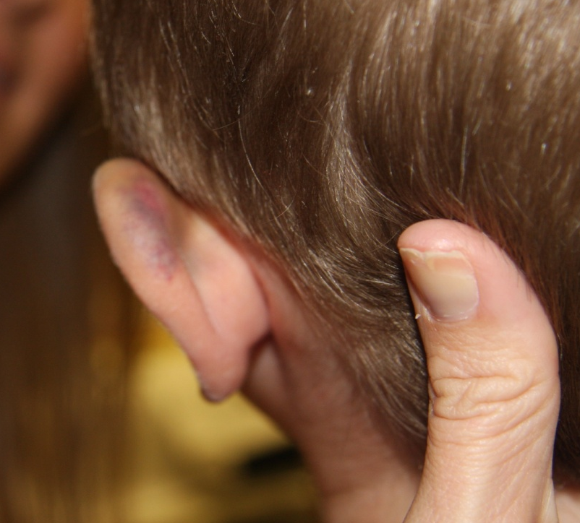
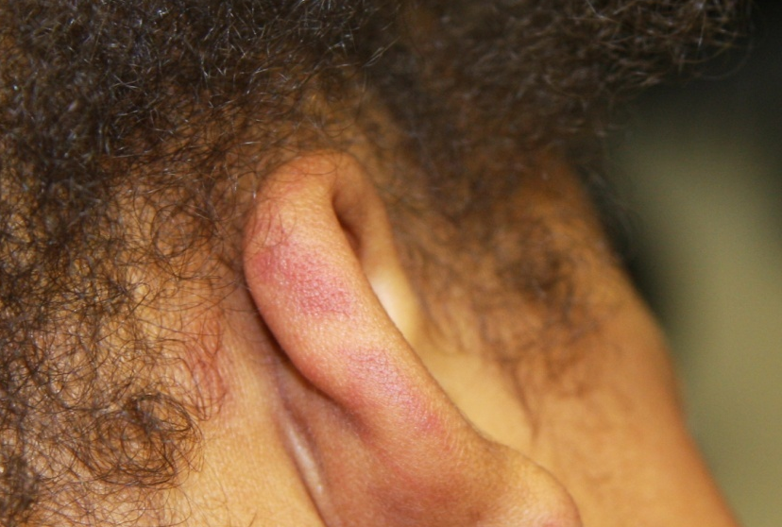
EARS
Notes:
Here are various examples of ear bruising. Child on left was picked up and thrown by his ear---so that is a crush injury. Child on the right was a victim of abusive head trauma (and the ear bruising was caused by blunt force trauma to the ear), and the little girl in the middle was found abandoned in a drug house, where she was found to have this ear bruising as well as other injuries. Her example is important, because it shows how bruising can appear red in color in children with darker skin pigmentation. So don’t forget that bruises can look red!

Slide 25
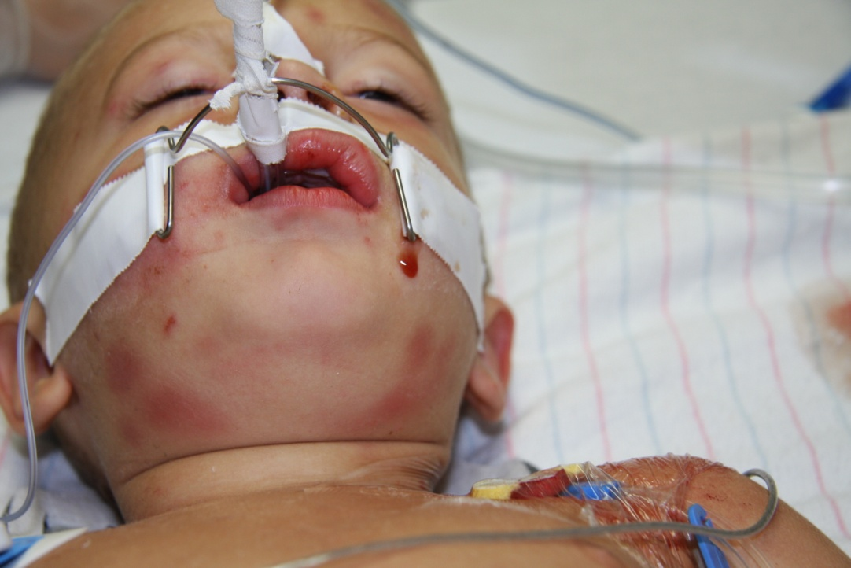
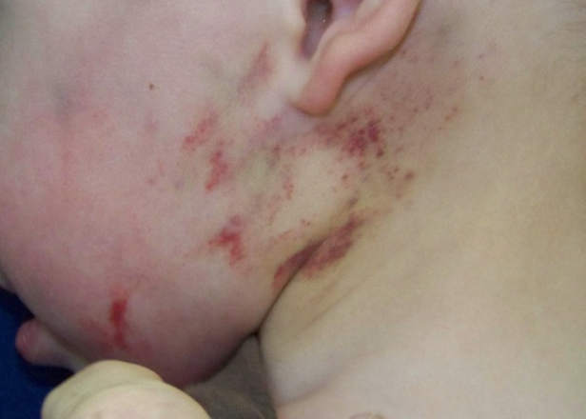
NECK
“Slept on a lego”
Notes:
These are different examples of neck bruising. Child on left was a victim of abusive head trauma and unfortunately died from his injuries. Child on the right was taken to an Immediate Care Center b/c mom thought he might have an ear infection (he was pulling on his ear.) When the nurse practitioner asked about the bruising, mother opined that perhaps he had slept on a large lego block that he had in his crib. Police later obtained a confession from mom’s boyfriend that he had strangled the child in the middle of the night out of frustration with the child’s crying. So, this is what strangulation bruising can look like.

Slide 26
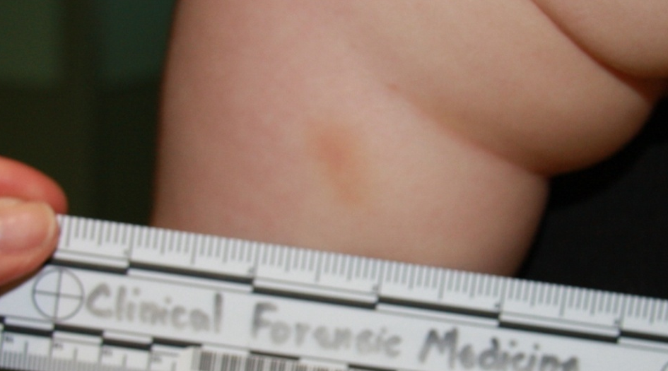
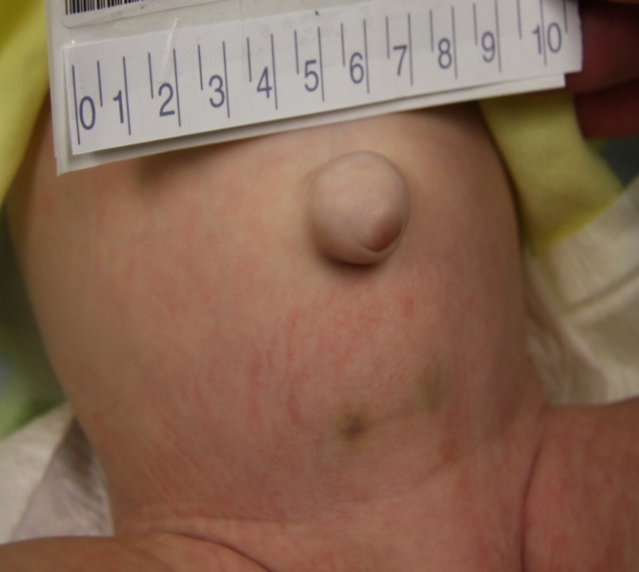
ANY Bruising, ANYWHERE, on a child who is not independently mobile (or less than 4.99 months)*
* Those Who Don’t Cruise Rarely Bruise!
Sugar, Taylor, Feldman et al. Bruises in Infants and Toddlers: Those Who Don’t Cruise Rarely Bruise. ARCH PEDIATR ADOLESC MED/VOL 153, APR 1999.
Blamed on car seat buckle
Notes:
Child on left was 6 weeks old, at pediatrician’s office for well child exam. When asked, mother claimed to have not noticed the bruises that morning and wondered aloud if the car seat buckle may have caused the bruising. A couple of issues with this: 1) He had on a diaper and an outfit, would be hard for buckle to actually catch skin, 2) he would have cried had that happen—either it happened or it didn’t. NO “MAYBE” ABOUT IT., 3) It doesn’t actually matter if the explanation sounds reasonable/plausible or not---if the bruising screens positive for TEN-4 FACESp then the child needs to be emergently evaluated. This infant was sent to the Emergency Department, and he was found to have 7 broken bones. Turns out there was severe domestic violence in the home, mother was aware father had caused the bruises, but she was too afraid to tell anyone.
Child on the right is almost the same history: 4 month old, well child exam, single bruise, sent to ED and had multiple broken bones.
Remember that those who don’t cruise (pulling up on furniture and taking steps while holding on) rarely bruise!!!

Slide 27
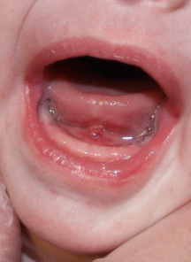
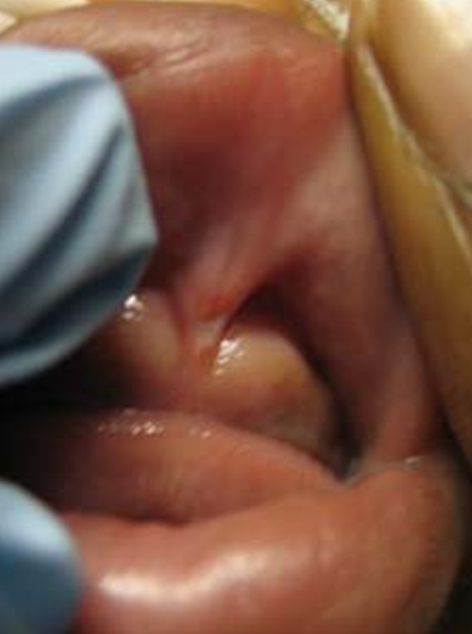
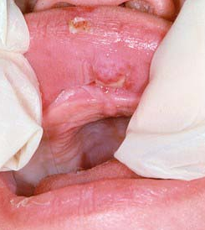
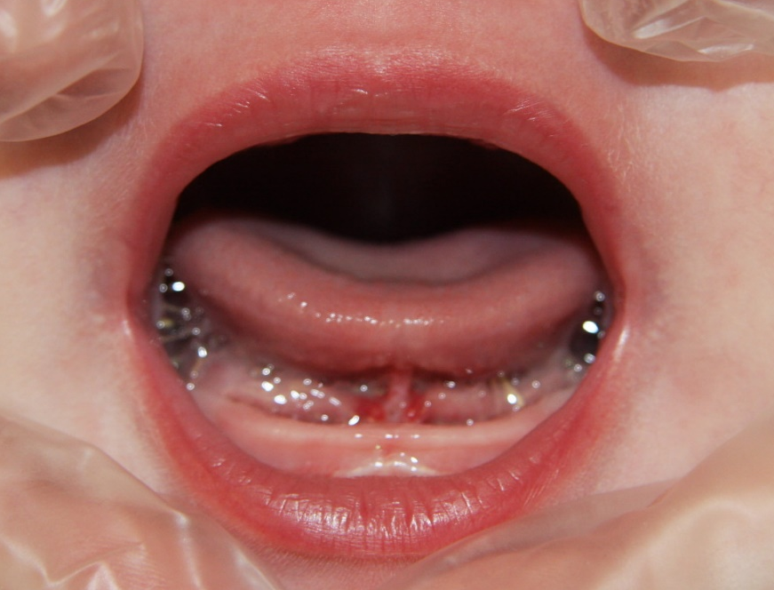
Frenulum
Notes:
The “F” of FACESp stands for frenulum. There is one behind our upper lip, lower lip, and under our tongue. Any of these can be injured from abusive blunt force trauma to the mouth. The frenulum under the tongue is usually injured when an object is forcefully shoved into the mouth.

Slide 28
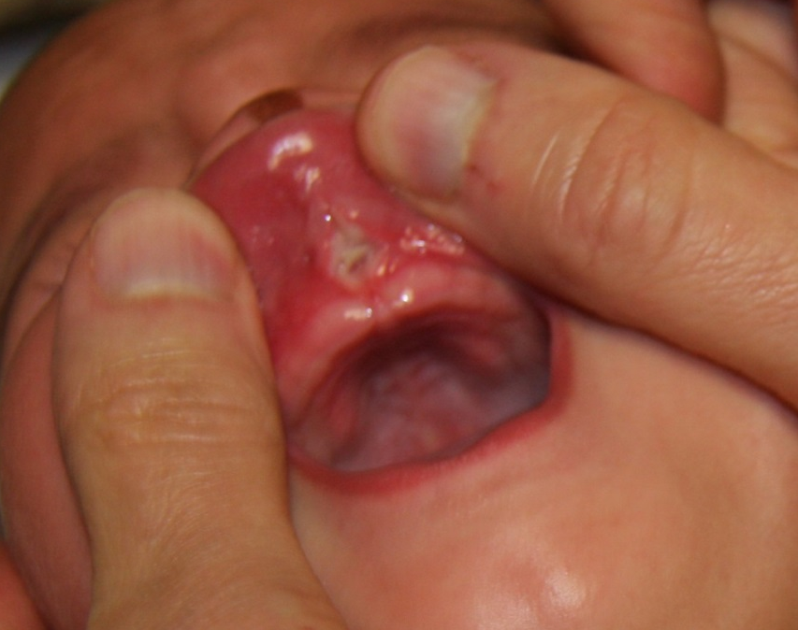
Frenulum
Notes:
Another example of a frenulum tear. Please note that these injuries are very specific for abuse when the occur in young, non-mobile infants. Once children are pulling up and taking steps, however, they can cause these injuries accidentally by hitting their mouths on solid objects (like the crib rail or a coffee table).

Slide 29

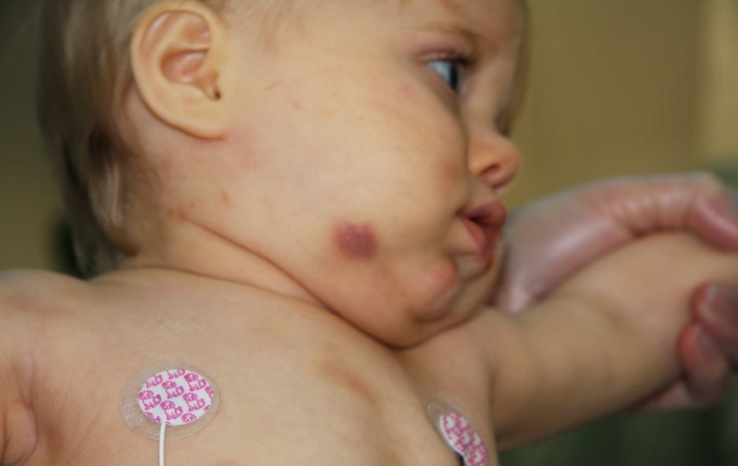
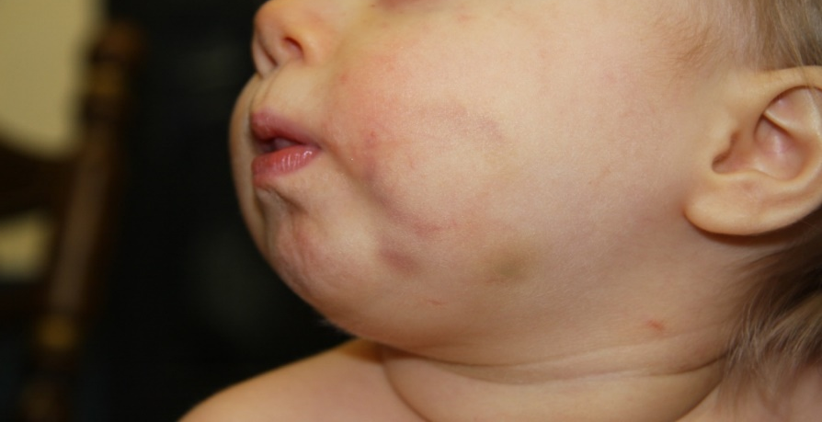
Angle of the Jaw
All three are victims of abusive head injury
Notes:
“A” in FACESp is for Angle of the Jaw. All of these are victims of abusive head trauma. This is a very ominous location for bruising---take it very seriously if you see it!!! These rarely if ever occur from accidental injury.

Slide 30
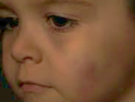
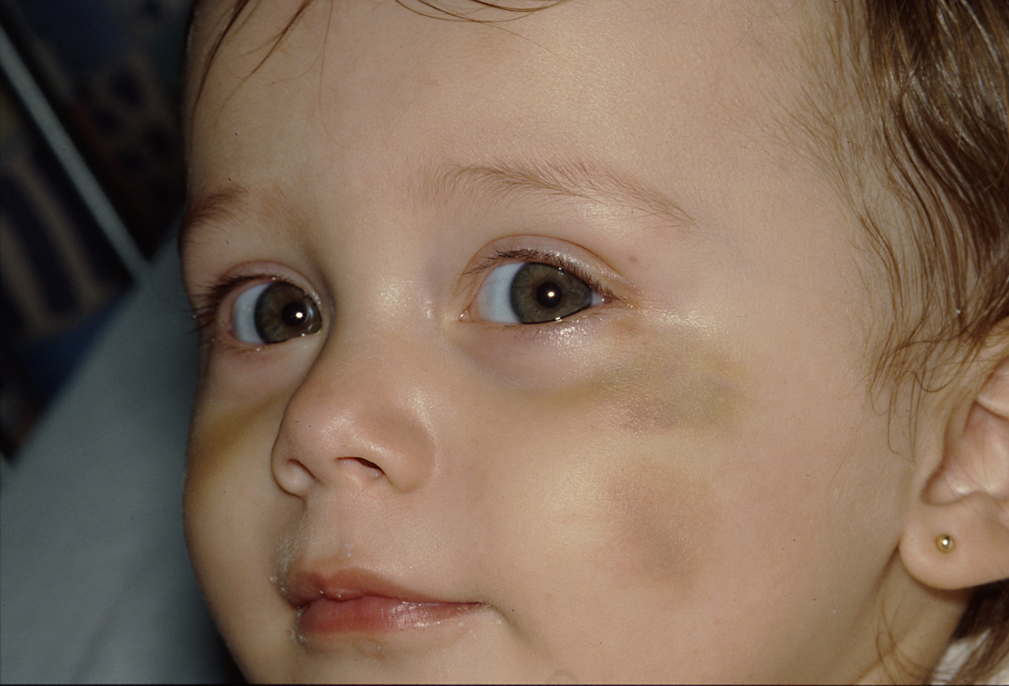
Cheek (fleshy)
Notes:
“C” in FACESp is for cheek—the soft, fleshy part that doesn’t have bone underneath. Both of these are examples of bruising to the fleshy part of the cheek, and this location is much less likely to be accidental than when the bruise is over a bony prominence, like the cheekbone.

Slide 31
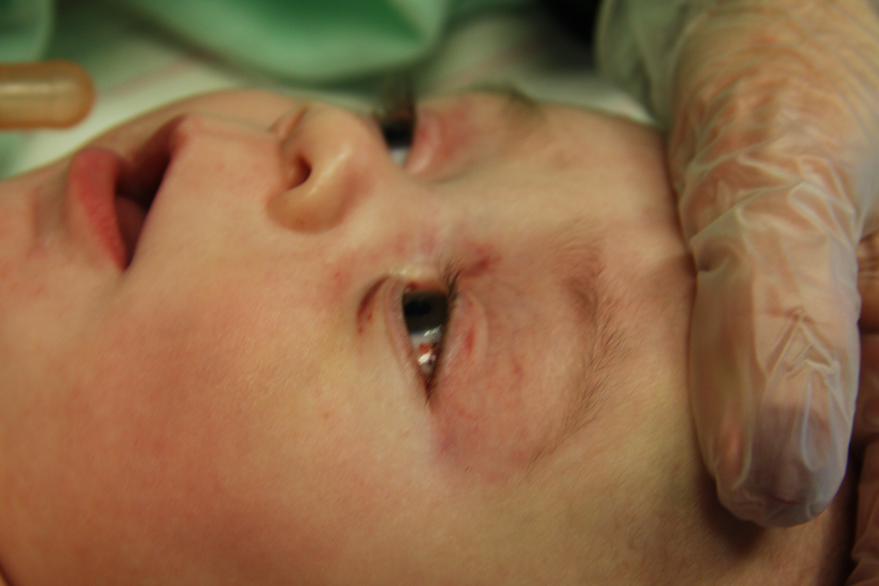
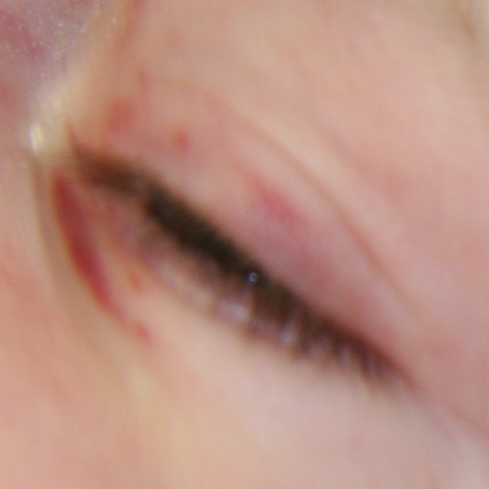
Eyelids
Notes:
“E” is for eyelids. The eyes are relatively protected areas, and eyelid bruising should be taken very seriously. Children do not cause bruises to their own eyelids by rubbing them. They can cause redness, or little scratches, but not bruising.

Slide 32
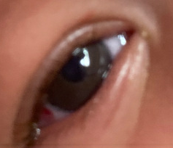
Subconjunctival hemorrhage
Notes:
“S” stands for subconjunctival hemorrhage. These areas of bleeding in the white part of the eye can be caused by direct blunt force trauma to the eye, but they can sometimes also occur when a child has severe vomiting, crying hard, or anything that causes them to bear down really hard.

Slide 33
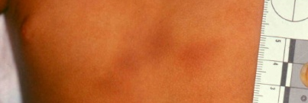
Patterned (more on patterned injuries later)
Notes:
“P” stands for patterned. This is the pattern we see when a child is punched with a fist. Beware of bruising that occurs in clusters like this---these are unlikely to be accidental.

Slide 34
REMEMBER: TEN-4-FACESp
Torso
Ears
Neck
Any child under 4.99 months
Frenulum
Angle of the jaw
Cheek (fleshy)
Eyelids
Subconjunctiva
Patterned
Notes:
Just a review.

Slide 35
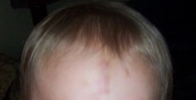
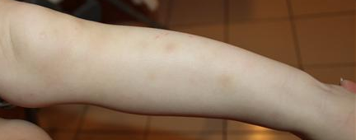
What is Normal?
Normal accidental bruises in toddlers and older children are typically
  On the front of the body
  Over bony prominences (forehead, elbows, knees, shins)
Notes:
An active, mobile 3 or 4 year old child can literally have 20 little fingertip-size bruises up and down the shins—these do not worry us.

Slide 36
Patterned Injuries
Slap marks
Loop marks from belts, ropes, cords, coat hangers, extensions cords, flyswatter handles
Other pattern injuries: shoes, brushes, kitchen utensils, flyswatters
Vertical bruises on the buttocks can be caused by whipping, paddling, or spanking.
Bite marks from adults vs. other children

Slide 37
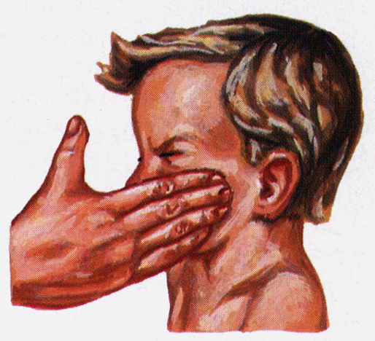
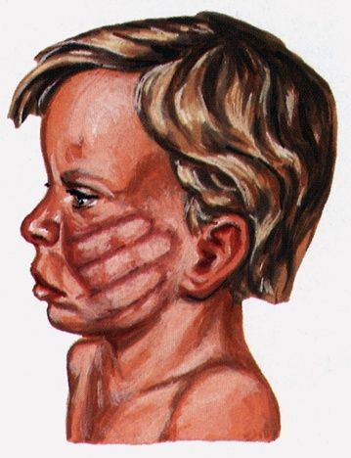
Inflicted slap mark
face slap drawings
Notes:
The bruising does not occur where the fingers impact the face. The bruising occurs around the edges. What is happening is that the speed and force of the impact of the fingers FORCES the blood from the vessels underneath where the fingers impact. The blood then overfills the vessels immediately surrounding the impacting object, causing bursting and a “negative” imprint of the impacting object. This is a very similar mechanism to the cause of loop marks and other patterned injuries as well (to be discussed shortly.)
We will seldom see the whole hand…usually just a couple of linear bruises.

Slide 38
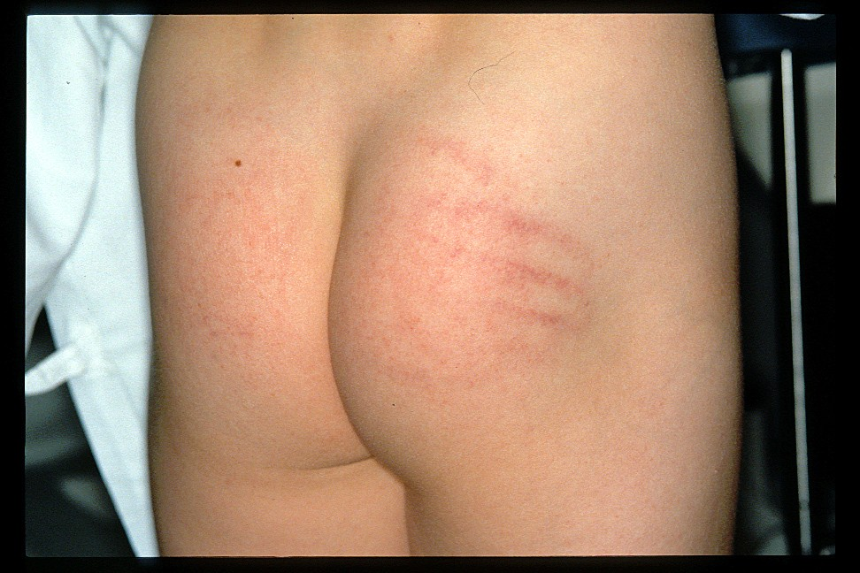
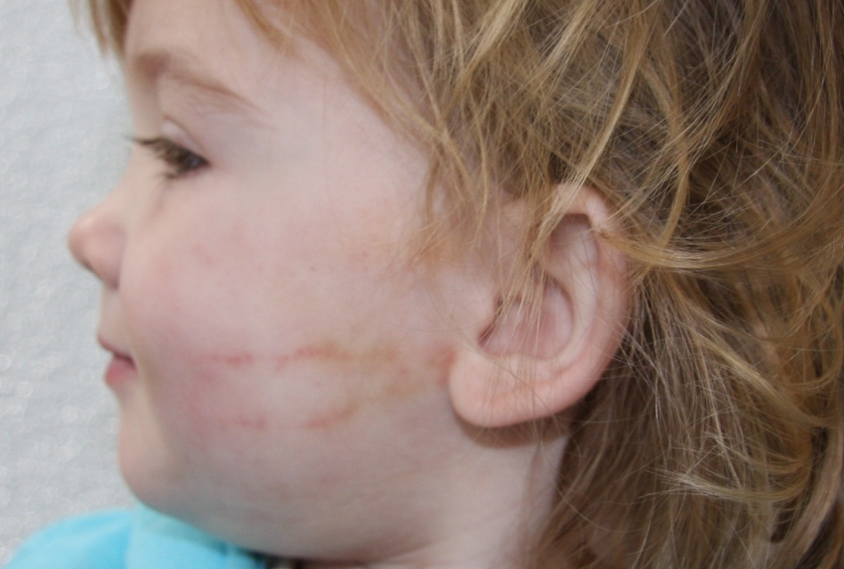
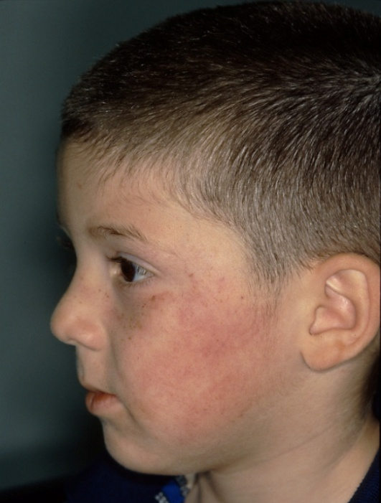
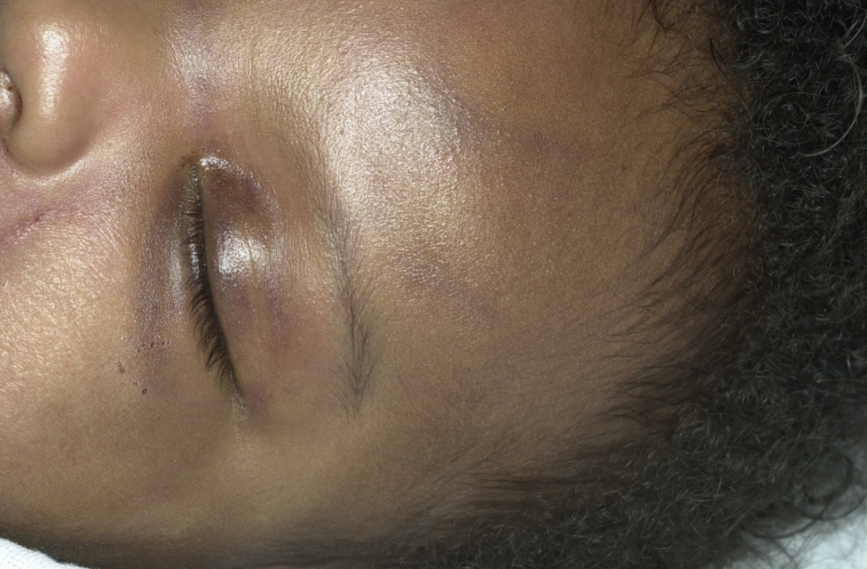
Inflicted slap marks
Notes:
More examples of slap marks. Note how difficult it is to see the bruising on the child with darker skin. This is a good reminder that we should always turn on all the lights available and/or take the children next to a window (or better yet, outside if it can be done privately).

Slide 39

Multiple blows with open hand
Notes:
This is an example of multiple linear, overlapping contusions from multiple blows to the buttocks with an open hand. The vertical bruise along the gluteal cleft is commonly seen with blunt force to the buttocks. The skin along the crease get crimped during the impact, causing the bruising.
DON’T LET THE LINEAR NATURE OF THE VERTICAL BRUISES TRICK YOU…THIS CAN BE CAUSED BY AN OPEN HAND, OR ANYTHING ELSE THAT IS FLEXIBLE ENOUGH TO CONFORM TO THE CURVES OF THE BODY. ALSO, THIS IS NOT “SPANKING”. THIS IS A PHYSICAL ASSAULT. “SPANKING” DOES NOT LEAVE INJURY. ONCE PHYSICAL PUNISHMENT HAS LEFT AN INJURY, IT HAS BECOME PHYSICAL ABUSE INSTEAD!

Slide 40
Slap marks
  Parallel linear contusions
  Denote the outline of the object
  Require an object flexible enough to conform to the contours of the face/body
  We do not see this pattern from impact with a rigid surface
  Usually on the left side of the face

Slide 41
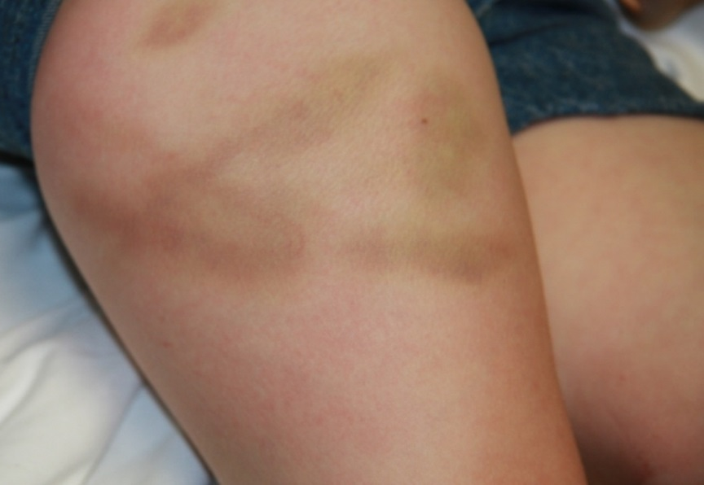
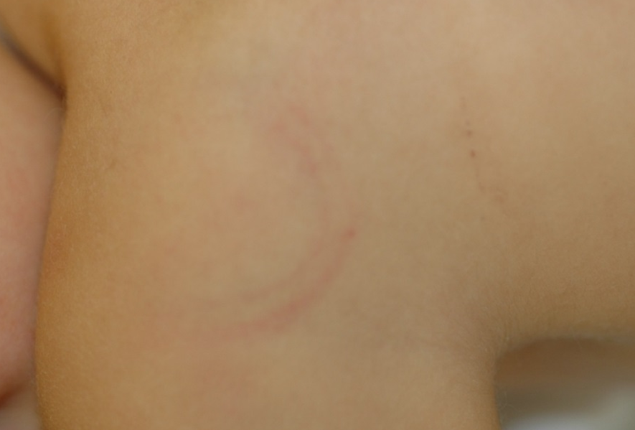
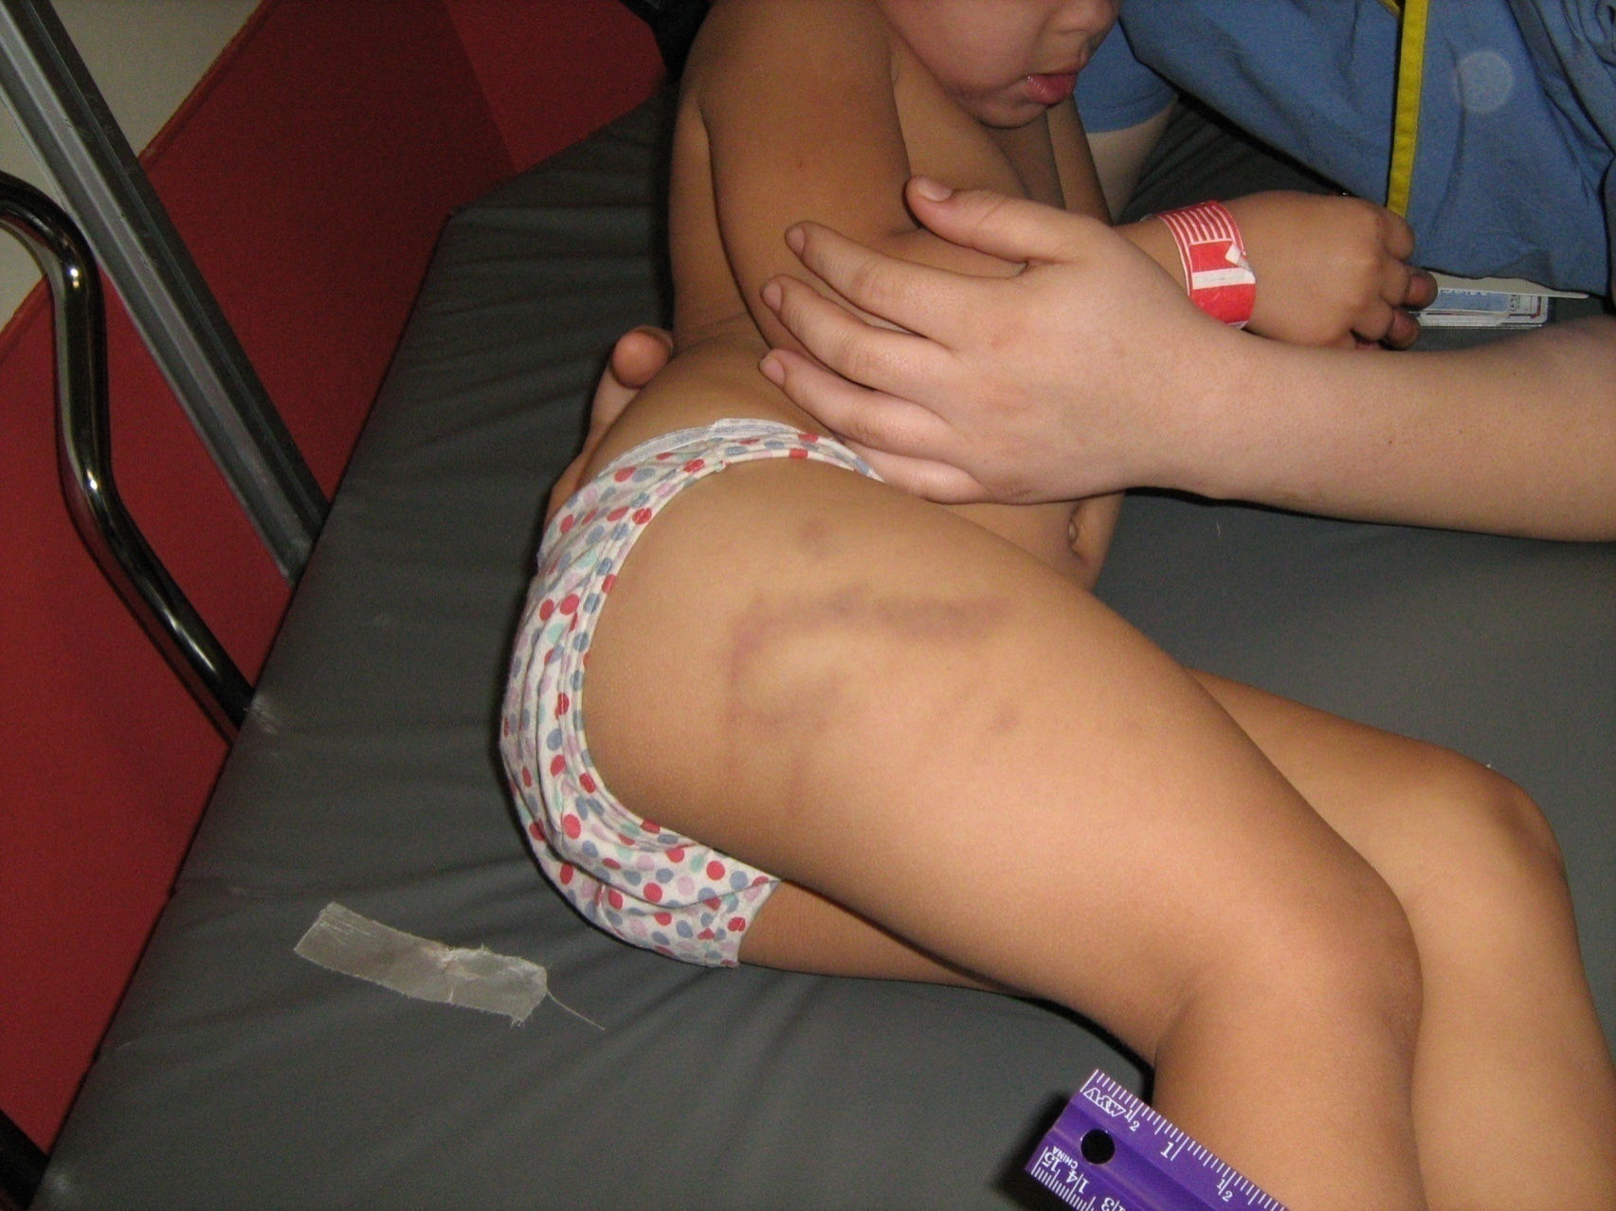
More loop marks…
Notes:
Remember to take at least two photos of each injury: one from a distance with landmarks (so we know what body part we’re looking at), and another up close for detail. Also, try not to obscure the borders of the injury with the measuring scale or patient label. Photo on top left is from a wire coat hanger. Middle/bottom is a belt. Top right we never learned what object it was, but we know it’s inflicted. Again, children cannot run into rigid objects and get loop marks.

Slide 42
Loop marks
“Whipping” impact with a thin, flexible object that can conform to the contours of the body
Diagnostic of inflicted injury—can’t get this pattern by bumping into (or falling onto) something rigid
Most common objects are belts, electrical cords, wire coat hangers and fly swatter handles
Notes:
Summary of information already shared about loop marks.

Slide 43
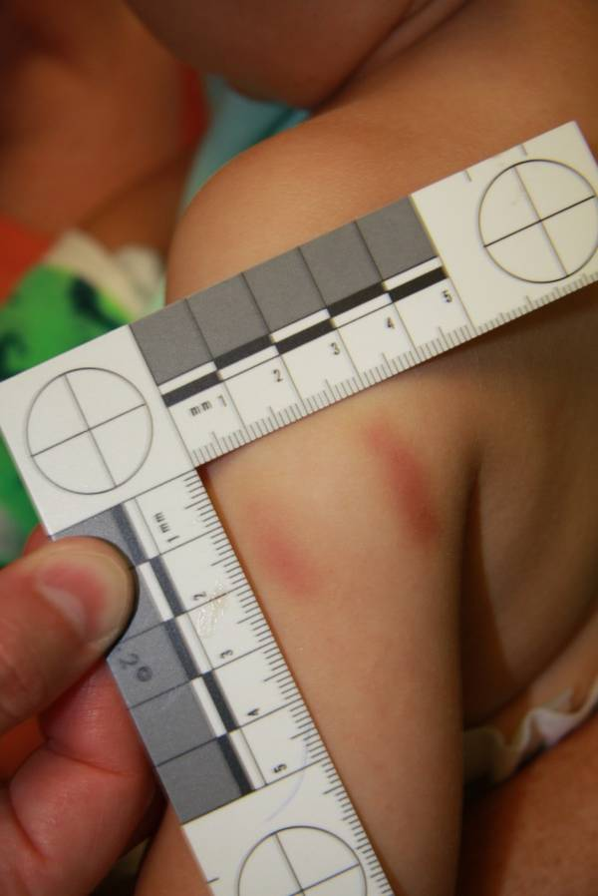
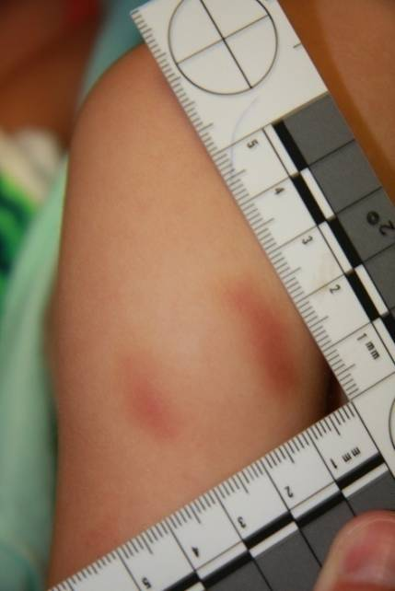
Inflicted adult bite marks
Notes:
43
ABFO ruler (stands for American Board of Forensic Odontology) used to help get a straight-on camera shot. If the camera isn’t perfectly perpendicular to the injury, l the circles will appear oval. (Neither of these photos is perpendicular, because the circles on the ruler look oval.) Aim to have the camera at a perfect right angle (90 degree angle) to the injury (Straight-on).
Inflicted adult bite marks scare us—they are indicative of a particularly sadistic abuser. A person must bite a child HARD to actually leave bruising behind. Don’t believe me? Try to self inflict an actual bruise from biting yourself. Bet you can’t!
What if the adult says they bit the child to teach them a lesson for biting? Well, while this is not an advisable form of punishment, one can “teach a child a lesson” without biting hard enough to leave a mark. If there is bruising left behind, then a tremendous amount of force was used that would be considered abusive. Without question.
And who are the most common perpetrators of human bite marks? Other little kids! It can be tricky to tell a child bite mark from an adult—leave that to the PFM teams. Also, don’t point out to the perpetrator that you know it’s a bite mark. Just ask, “what happened here?” and document their answer. If they don’t admit it is a bite mark, ask if there are other children around (but still don’t mention that it’s a bite mark.) If the child hasn’t been around other young children (like in daycare setting), then you know it was caused by an adult.
Think of bite marks any time you see bruising that looks like parentheses ( ) or circular. We describe these as “opposing curvilinear contusions.”

Slide 44
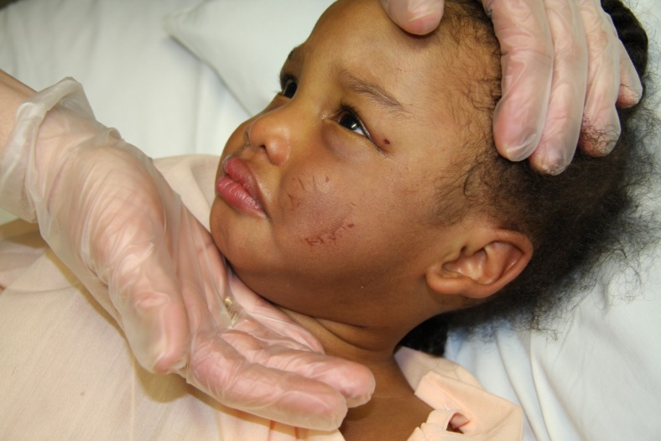
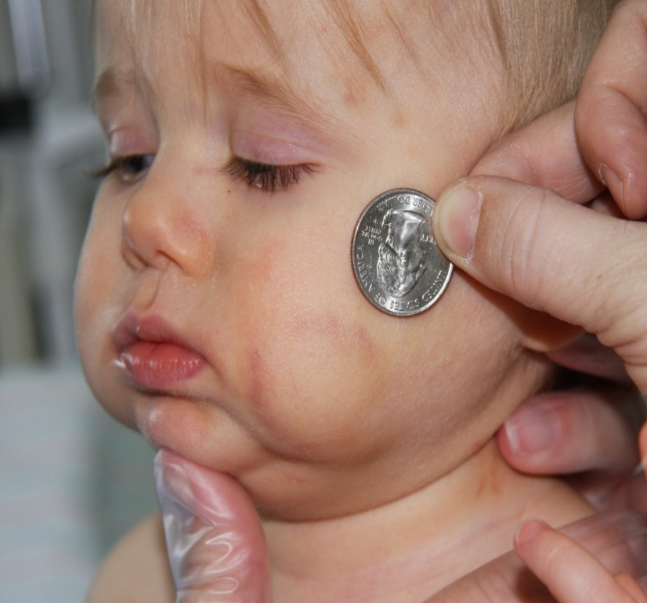
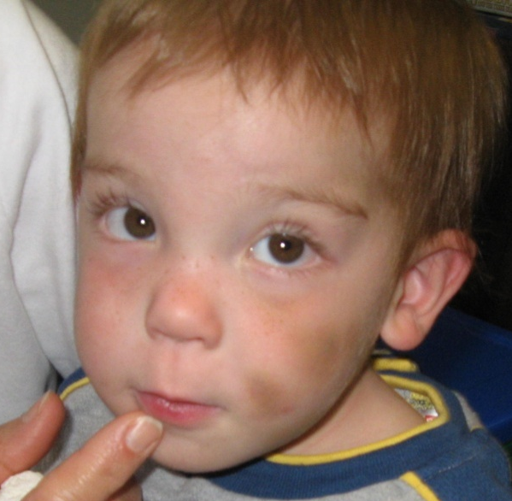
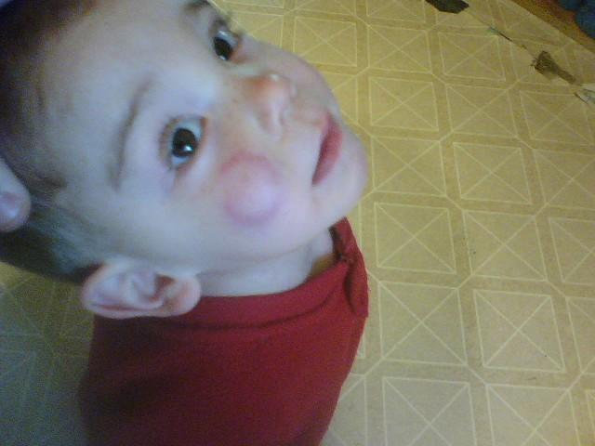
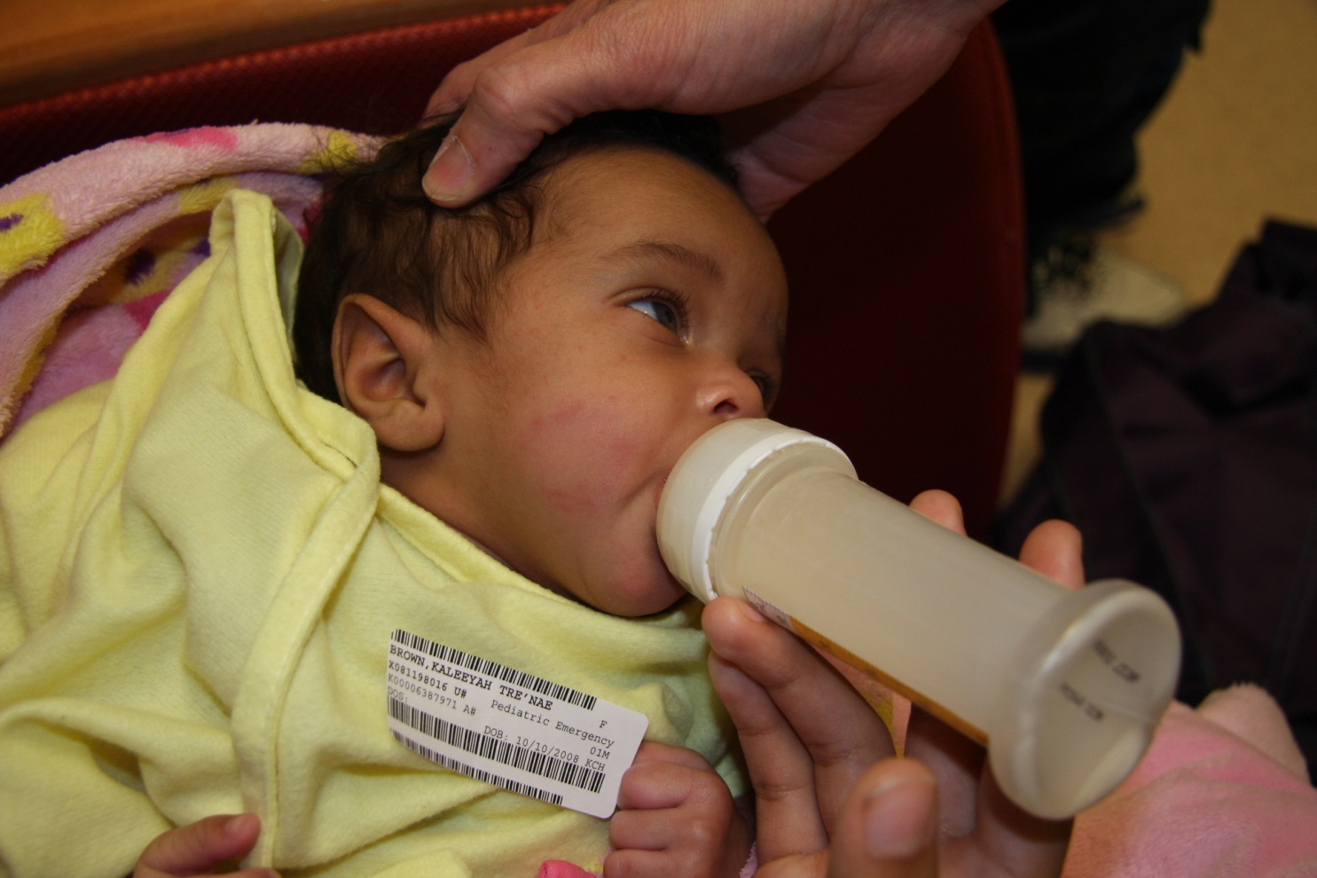
Inflicted adult bite marks
Notes:
All inflicted by adults. Note: many times, perpetrators will readily admit to biting the child, but will phrase their “confession” as “We were play-biting…I didn’t think I hurt him.” Understand that a bite that leaves contusion/bruise is extremely painful when it is inflicted. These children (assuming they are neurologically normal) would have cried/screamed when injured.

Slide 45
Bite marks
Inflicted adult bite marks are very worrisome—typically indicate a more sadistic abuser
Measurement of diameter can be helpful, but determination of adult vs. child can still be difficult
Swabbing fresh bite marks can help identify perpetrator by DNA
Photography of bite marks (and all inflicted injuries) is very important—include scale
Don’t forget the most common
“perps” of bites: toddlers!
Notes:
Summary of facts about bite marks.

Slide 46
Bruising Summary
Bruising is extremely rare in pre-ambulatory (not yet pulling up and taking steps) infants.
Bruising in infants is a significant indicator of abuse, must be reported to DCBS and usually police, and must be medically evaluated.
Bruising is the most overlooked sign of abuse.
Remember the TEN-4-FACESp Bruising Rule.

Slide 47
The Medical Evaluation
  Not all medical facilities or medical providers have the training and expertise to complete this evaluation.
  Regardless of your role in the process, you should feel empowered to advocate for the appropriate medical evaluation for suspected victims.
  This is one of our biggest challenges in the medical community: training all the providers who see and care for children about the recognition and evaluation of child physical abuse/AHT.

Slide 48
The Medical Evaluation for AHT
  Head CT (looking for subdural bleeding, brain swelling)
  Skeletal survey and follow-up skeletal survey in 10-14 days
  Eye exam (to look for retinal hemorrhages)
  Trauma and bleeding labs to screen for signs of internal injury or bleeding disorder
  MRI of the brain and spinal cord if CT is abnormal (MRI can demonstrate subtle brain injury that CT can miss)
  Photograph all visible injuries and call DCBS and police immediately if AHT is suspected
Notes:
Note: If healing injuries are identified on the follow-up, the medical personnel involved can help explain why this did NOT occur while child was in foster care. THAT SAID, this is one reason not to delay the follow-up. The longer the child is in foster care beyond the initial two weeks, the less clear it is when the healing bone injuries occurred.

Slide 49
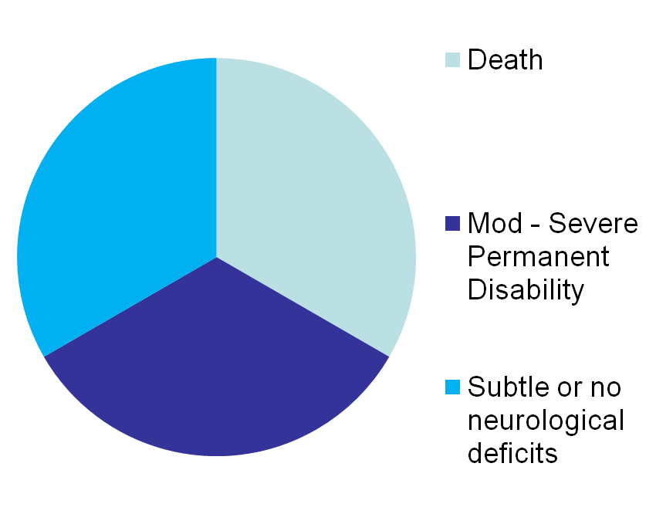
AHT Outcomes
Research is ongoing regarding the subtle brain changes that can occur after Abusive Head Trauma. The full spectrum of disability hasn’t yet been defined.
Disabilities include:
  Learning disabilities
  Emotional/behavioral issues
  Speech and language delays
  Vision/hearing
  Hormone/growth problems (due to pituitary injury)

Slide 50
What is the prognosis for victims?
  Long-term disability high amongst survivors—up to 90% affected
  Severity of disability can range from mild/subtle to permanent vegetative state.
  Research is ongoing regarding the subtle brain changes that can occur after abusive head trauma. The full spectrum of disability hasn’t yet been defined.

Slide 51
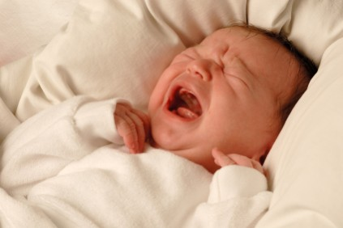
Triggering situations
  Crying baby
  Feeding issues/frustration
  Toilet training
  Child’s misbehavior
  Punishment gone awry
  Argument/family conflict
  Caregiver stressors outside the home, including financial concerns, job loss, legal trouble, relationship problems
Notes:
Optional Crying Baby Discussion/Demonstration:
Turn on crying and begin talking about triggers. As the group becomes fidgety, use this to start a discussion about the physiological changes in the body—heart rate increasing, blood pressure rising, feelings of anxiety. Ask the group to consider how this would feel if it were their child and was happening multiple hours per day and night for an extended period. If time allows, ask someone to share a story about how stressful caring for a crying baby can be. Point out how quickly caring for a crying baby can become overwhelming.
The common theme which accompanies some incidents of child abuse is the culmination of multiple stressors. This slide illustrates examples of situations which can be stressful and increase the likelihood of child abuse. It is important to note that among older children who are victims of PAHT, toilet training is a high risk time. Though most cases of PAHT involve infants, older children are not immune.

Slide 52
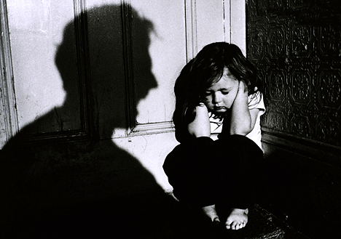
Family Factors
  Domestic/family violence
  Single parent/military deployments/redeployments
  Unemployment/financial stressors
  Isolation
  Poverty/limited resources
  Animal abuse

Slide 53
Caregiver Characteristics
  Substance use disorders
  Undiagnosed/untreated/unstable mental illness
  Low self-esteem
  Poor impulse control
Notes:
Optional Crying Baby Discussion/Demonstration:
Turn on crying and begin talking about triggers. As the group becomes fidgety, use this to start a discussion about the physiological changes in the body—heart rate increasing, blood pressure rising, feelings of anxiety. Ask the group to consider how this would feel if it were their child and was happening multiple hours per day and night for an extended period. If time allows, ask someone to share a story about how stressful caring for a crying baby can be. Point out how quickly caring for a crying baby can become overwhelming.
The common theme which accompanies some incidents of child abuse is the culmination of multiple stressors. This slide illustrates examples of situations which can be stressful and increase the likelihood of child abuse. It is important to note that among older children who are victims of PAHT, toilet training is a high risk time. Though most cases of PAHT involve infants, older children are not immune.

Slide 54

Unrealistic Expectations

Slide 55
More Caregiver Characteristics
  Unrealistic expectations of child’s behavior
  Immature parent/poor coping skills
  Criminal history
  CPS history/prior removals
  Caregivers abused as children**

Slide 56
Child Characteristics
  0-3 years of age
  Drug affected/Neonatal Abstinence/Neonatal Opiate Withdrawal Syndrome
  Premature birth/NICU stays
  Multiples
  Colic
  Physical/developmental disabilities
  Chronic illness
Notes:
Again, while all of the are true risk factors, it does not mean all or even most of these children will be maltreated—it simply means their risk is higher compared to typical or older children.

Slide 57
Fatality Risk Factors
Top four modifiable risk factors for fatal abusive injury include:
Substance Use Disorder
Domestic Violence
Criminal History
Untreated/undiagnosed mental illness
among adult caregivers in the home.

Slide 58
Who are we most likely to overlook?
  White families
  Two-parent families
  Middle-class, well-educated parents
  Families perceived to be similar to our own
  Very young infants (may have normal neuro exam)
  Infants with nonspecific symptoms only
  Jenny C, Hymel KP, Ritzen A, Reinert SE, Hay TC. Analysis of missed cases of abusive head trauma. JAMA. 1999;281:621–626

Slide 59
Documentation 101
  First-responder documentation is often a crucial component of the legal case.
  Document what you see, the people present, and any unusual or unexpected behavior.
  Document statements that were made…as close to word-for-word as possible.
  Pass along your concerns to the receiving hospital, DCBS, and law enforcement.
Notes:
I took some info. out that I would leave in for other groups. I was trying to keep FP in mind.
DOCUMENT.DOCUMENT
Pictures are great…bruises change quickly.
CAREGIVER INFORMATON….really important…we see changing stories, delay in treatment….these are important.

Slide 60
Documentation 101
  Document visible injuries
  Make special note of bleeding from mouth or nose
  Frenulum tears and other oral trauma due to abuse are often blamed on instrumentation by EMS.
  Exercise caution when asking questions.
    Difference between EMS and LE responsibilities
    Observe, Listen and Report
Notes:
CAREGIVER INFORMATON….really important…we see changing stories, delay in treatment….these are important.
Photography should be left to the hospital, law enforcement, or DCBS.
***Follow departmental policies!***

Slide 61
Scenario 1
911 is called for a 4-month-old baby who is unconscious at home. Mom is home alone with child and reports that he was napping, and she heard some “funny noises” from his room. She found him “twitching” in the crib and was unable to wake him up. He is now unresponsive with agonal breathing.

Slide 62
How your documentation helps…
Mom changed her history about where and in what position the child was found (from what she told EMS)
Mother made 4 phone calls to friends for “advice” prior to calling 911
EMS documented that mother appeared “uninterested” in the condition of the child and was on the phone the entire time they were there
EMS documented that there were no sheets in the crib where mother allegedly found the child

Slide 63
Scenario 2
911 is called for a 6-week-old baby with respiratory distress and “blood in the mouth and nose”. Both parents and 2-year-old sibling are home when EMS arrives. Father reports that he found child in bassinet “choking” and that when he picked her up, she spit up blood and began having difficulty breathing.

Slide 64
Scenario 2, continued
Baby is lying in father’s arms in the front room and has a small amount of gross, bright red blood smeared on chin. She has gasping respirations. She has blood smeared on her sleeper. The bassinet is not readily visible. Medical control recommends intubation due to the respiratory distress.

Slide 65
Scenario #2, continued
Upon intubation, a torn maxillary frenulum is noted with active bleeding. There is also an apparent injury to the posterior pharynx that is visualized during intubation. The intubation itself is not traumatic, and the tube passes easily on first attempt with good visualization of the cords. Paramedics clearly document all of these findings. (Great job, Paramedics!!!)

Slide 66
Back to Scenario 2…
The patient was found to have a traumatic, inflicted perforation of the posterior pharynx, a torn frenulum, 3 healing rib fractures, and a liver contusion.
Father had been suspected in the death of another child from a previous relationship
Everyone who interacted with the family described them as “very nice” and couldn’t imagine the father doing such a thing.

Slide 67
Child maltreatment occurs in all ethnic, social and economic groups.
It can, and does, occur in “nice” families.

Slide 68
Why paramedic documentation was so important…
It would have been impossible to tell if trauma was due to intubation attempt without proper documentation.
Patient also had esophagitis from GERD and reportedly had blood-tinged emesis in the past. The blood on the child and clothing was clearly described as “gross, bright red blood”, as opposed to blood-tinged emesis (as might be expected in severe GERD).

Slide 69
Scenario 3
911 is called to the home of an 8-month-old infant with vomiting. When paramedics arrive, the child appears well, smiles and interacts normally with medical providers. Mom just got home from work, and the child had vomited 4 times in 15 minutes. Mom’s boyfriend had been caring for the child for the previous 8 hours. On exam she had two subtle jawline bruises.
Baby was transported to the hospital.

Slide 70
Scenario 3, continued
Her AST was 2500, ALT 1600, amylase 450, lipase 600. She had a small liver laceration, and a pancreatic contusion. She was observed in the hospital for 24 hours, during which she developed fever and an acute abdomen. She was taken to the OR and found to have a duodenal hematoma with perforation. She recovered completely.

Slide 71
Why paramedic documentation was important…
It brought the subtle injuries to the attention of emergency department providers promptly.
Paramedics were able to ask mom if she had noticed the bruises before.
It eliminated the theory that somehow paramedics caused the bruises.

Slide 72
Important messages for first responders….
Always keep abuse in mind
Be aware of common scenarios
Be an ACTIVE observer
Document, Document, Document

Slide 73
So How Do We Prevent This?
1) Education about infant crying and normal development:
  Crying is normal in infancy.
  Provide specific tools for soothing a crying infant, including permission to place the infant in a safe place and walk away/take a break.
  Help parents have reasonable expectations
Notes:
Educating parents about infant crying can reduce the number of children who die from PAHT.

Slide 74
So How Do We Prevent This?
2) Early recognition of abusive injuries and protective interventions:
  Contrary to popular belief, abusive head trauma is rarely a one-time event. It is more often the culmination of an ongoing escalation of violence against the child—and non-offending caregivers are often unaware of the abuse. Bruising in babies is not normal!
Notes:
Educating parents about infant crying can reduce the number of children who die from PAHT.

Slide 75
So How Do We Prevent This?
3) Promote healthy relationships and caregivers
  Educate parents about choosing appropriate caregivers for their babies
  Educate young people about safe and healthy intimate relationships
  Drug/alcohol treatment
  Mental health treatment
Notes:
Educating parents about infant crying can reduce the number of children who die from PAHT.

Slide 76
Prevention: What Can I Do?
  Make a report to DCBS when you suspect abuse.
  1-877 KY-SAFE-1 https://prd.chfs.ky.gov/ReportAbuse/home.aspx
  Don’t be afraid to share what you’ve learned today with the other professionals at your workplace AND in your social/family circles.
  Document any signs/symptoms you see.
  Take pictures of injuries (or help establish a protocol in your organization for someone else to take pictures.)
  Document any information you receive from a parent/caregiver when you have suspicions.
Notes:
Documenting observations of caregiver behaviors, comments, and interactions with others can be beneficial during the course of an investigation. It is important to note the importance of documenting observations of specific behaviors rather than the interpretation of a situation. BUT remember---the role of most social workers (unless you are a DCBS investigator!) is to observe, document, and report….NOT to investigate.

Slide 77
Reporting to CPS
You may remain anonymous, but that hinders CPS’s ability to investigate
They will want to know child’s identity, the person believed responsible for maltreatment (if known), nature and extent of maltreatment, where the child can be found
Be specific about your concerns and how certain you are
If you are worried for the child’s life, say so
Mention siblings if applicable
Notes:
As a reminder, is it rare for a child to die or be seriously injured the 1st time they are abused. Making a report can prevent further abuse.
Thorough documentation is important in assisting child protective services and law enforcement investigations. It is critical to protection.

Slide 78
Reporting to CPS
Give facts, not opinions
  “I have a 4-month-old with bruises to the head, abdomen and buttocks.”
  “These are injuries that are indicative of abuse in a child this young.”
Specify your concerns
  “I’m concerned there could be internal injuries.”
  “I don’t feel comfortable leaving the child alone with her caregivers.”
  “If this child does not receive their seizure medication as prescribed, they could have permanent impairments.”
Ask the hotline worker to read back your report
Request a call back
Notes:
As a reminder, is it rare for a child to die or be seriously injured the 1st time they are abused. Making a report can prevent further abuse.
Thorough documentation is important in assisting child protective services and law enforcement investigations. It is critical to protection.

Slide 79
Reporting to CPS
CPS requests that PROFESSIONALS use the online reporting option.
Not for emergent cases.
Benefit: No hold time, and YOU control what information is put in the system.
https://prd.webapps.chfs.ky.gov/reportabuse/home.aspx
Notes:
As a reminder, is it rare for a child to die or be seriously injured the 1st time they are abused. Making a report can prevent further abuse.
Thorough documentation is important in assisting child protective services and law enforcement investigations. It is critical to protection.

Slide 80
AHT: Take-Home Messages
  Abusive Head Trauma is the most dangerous and deadly form of child physical abuse.
  Experience tells us that we often fail to recognize early warning signs—and we therefore miss opportunities to intervene and prevent further harm to abused children.
  We all play a vital role in observation, documentation, and reporting.
  The absence of risk factors is NOT the same as the absence of risk.

Slide 81
AHT: Take-Home Messages
  TEN-4-FACESp Bruising Rule
  Long term effects from AHT vary from subtle learning and behavioral issues to complete dependence for all care.
  Education of caregivers regarding techniques for soothing a crying infant and the dangers of shaking can be an effective prevention tool, as well as promoting healthy caregivers and relationships and early recognition and reporting.

Slide 82
Thank you for your attention.
Questions/Comments?
Notes:
Add resources

